Slide 1
Arms, Legs, Wheels, Tracks, and What Really Drives Them Effectors and Actuators

Slide 2
Effector
An effector is any device on a robot that has an effect (impact or influence) on the environment.
Effectors range from legs and wheels to arms and fingers. The robot’s controller sends commands to the robot’s effectors to produce the desired effect on the environment, based on the robot’s task.

Slide 3
Actuator
All effectors have some mechanism that allows them to do their work. An actuator is the mechanism that enables the effector to execute an action or movement.
In animals, muscles and tendons are the actuators that make the arms and legs and the backs do their jobs. In robots, actuators include electric motors and various other technologies.

Slide 4
A passive walker: a robot that uses gravity and clever mechanics to balance and walk without any motors.

Slide 5
Active vs. Passive Actuation
In all cases, the action of actuators and effectors requires some form of energy to provide power. Some actuators use passive actuation, utilizing potential energy of the effector and its interaction with the environment instead of active power consumption.
A glider is an example of this.

Slide 6
Types of Actuators
Electric motors - Video
Hydraulics - Video
Pneumatics - Video
Photo-reactive materials
Chemically reactive materials
Thermally reactive materials
Piezoelectric materials
Crystals create a charge when pushed or pressed.

Slide 7
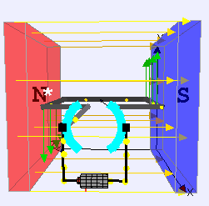
Motors
Compared with all other types of actuators, direct current (DC) motors are simple, inexpensive, easy to use, and easy to find.
Motors have a copper wire wound in a way that creates magnetic fields that "push" the rotor inside of the motor around in a circle.
To make a motor run, you need to provide it with electrical power in the right voltage range.
Low voltage, slower movement. Higher voltage, faster movement (but more wear on the motor and can burn out if run fast for too long).
Like a lightbulb on a battery. More voltage means a brighter light.

Slide 8
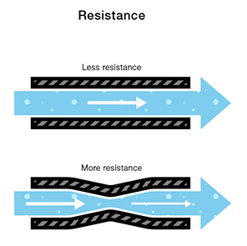
Electricity – Example using Water
We define voltage as the amount of potential energy between two points on a circuit. One point has more charge than another. This difference in charge between the two points is called voltage.
We can think of the amount of water flowing through the hose from the tank as current.
It stands to reason that we can’t fit as much volume through a narrow pipe than a wider one at the same pressure. This is resistance. The narrow pipe “resists” the flow of water through it even though the water is at the same pressure as the tank with the wider pipe.

Slide 9
Ohm’s Law
Combining the elements of voltage, current, and resistance, Ohm developed the formula:
V=IR
V - Voltage in volts
I - Current in amps
R - Resistance in ohms
Electrical power is measured in watts. In an electrical system power (P) is equal to the voltage multiplied by the current.

Slide 10
Battery Packs
The mAh specification of a battery stands for milliampere-hours. mAh is the amount of milliamperes which a battery can provide (to a circuit or device) for the amount of hours specified in its specification.
Thus, a battery of a 1900mAh can provide 1900mA (milliamperes) for 1 hour of time.
Usually a circuit will not demand 1900 mA of current all at once for operation.
A circuit may instead only need 380mA of current for operation. In this case, the battery supplies 380mA for 5 hours, since 380*5=1900. Or for other circuits, it can supply 190mA of current for 10 hours, since 190*10=1900.

Slide 11
Motors will stall if the motor tries to turn but is prevented from moving. The motor will draw a lot of current from the battery and heat up. You can burn out a motor if run stalled for too long.

Slide 12
Gearing of motors
Combining different gears is used to change the speed and torque (turning force) of motors.
Work, as defined in physics, is the product of force and distance.
Rotational Velocity is specified in Rotations Per Minute.

Slide 13
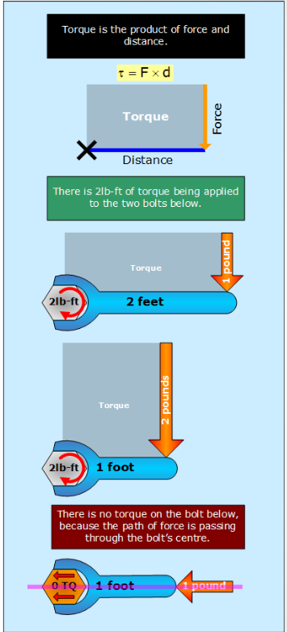
Torque
Torque can be considered as a special subtype of work:
TORQUE = FORCE x DISTANCE
But TORQUE is a measurement of ROTATIONAL FORCE and the DISTANCE is equivalent to the RADIUS of the rotational circumference.

Slide 14
Servo Motors
Motors that can turn their shaft to a specific position are called servo motors or servos for short.
A position sensor for the motor shaft, to track how much the motor is turning, and in what direction.

Slide 15
Motor Controls
Most robot actuators use position control, in which the motor is driven so as to track the desired position at all times. This makes motor-driven actuators very accurate, but also very stiff.
Such examples are 2D/3D printers.
Robots moving or placing objects

Slide 16
Torque Control: the motor is driven so as to track the desired torque at all times, regardless of its specific shaft position.
Such as limiting the turning a wheel in a race car simulator.
Velocity control: Goal of velocity control is to regulate motor speed.
Such as a spinning motor in a fan.

Slide 17
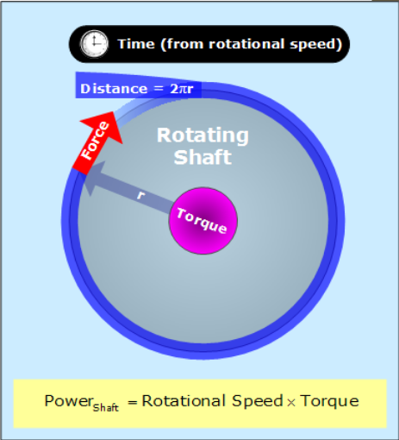
Power
The amount of work (Torque) a motor do is (W=FxD)
If we want more TORQUE (for acceleration) we can reduce rotational speed, if we want more Rotational Velocity (Distance/Speed) we can reduce Torque.
How do we do this?
With the use of Gears!

Slide 18
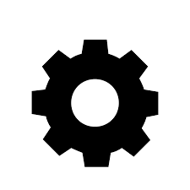
Gears
Combining different size gears is one way to change the Torque (force output) and Rotational Velocity (speed, distance over time) of a motors output.
Gears are wheels with teeth. Gears mesh together and make things turn. Gears are used to transfer motion or power from from one moving part to another.

Slide 19
Gears – The Purpose
Gears are generally used for one of four different reasons:
To reverse the direction of rotation
To increase or decrease the speed of rotation
To move rotational motion to a different axis
To keep the rotation of two axis synchronized
Sports Car vs Garbage Truck analogy.
Speed and Power

Slide 20
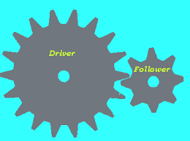
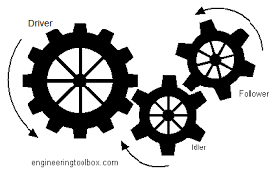
Gear System
Compound Gears

Slide 21
Gear Ratio

Slide 22
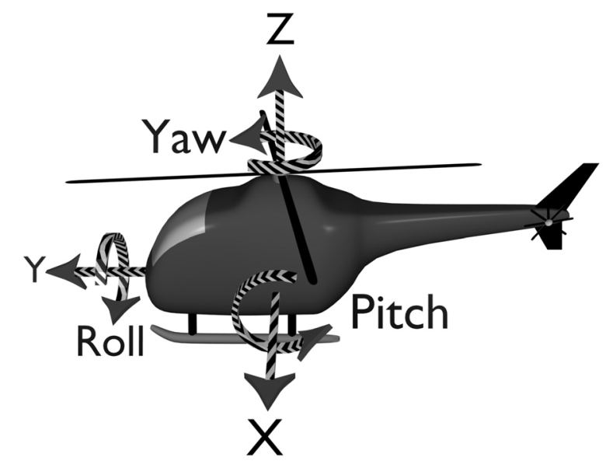
Degrees of Freedom
A degree of freedom (DOF) is any of the minimum number of coordinates required to completely specify the motion of a mechanical system. You can think of it informally as a way in which the system (robot) can move.

