Slide 1
CHAPTER NINE
ANIMATION

Slide 2
PINNACLE OF MODERN MULTIMEDIA
Animation draws inspiration from each of the other media.
Computer is a partner in creative expression.
It lowered costs and increased ease of creating animation.
It supports creative expression through:
Interactivity
3-D sensory experience
Embodiment and implementation of rules of behavior.

Slide 3
ANIMATION BASICS
Animation: rapidly displayed sequence of individual, still images.
Made possible by "persistence of vision."
Images formed on the retina persist for a short period of time after stimulus has disappeared.
This physical memory of the retina produces the illusion of motion.
Early animating devices:
Thaumatrope
Zoetrope.
View sample Thaumatrope

Slide 4
ANIMATION BASICS
Flipbook technique
Still images showing a different stage of motion are created on each page.
Pages are "flipped" in rapid succession to view the motion. Animation basics used in flipbook:
Quality of motion is based on rate of display.
Speed is based on differences between images.
Onionskinning: a technique used to draw new image based on the previous image.
Registration: physically aligns images with one another.
View a sample FlipBook

Slide 5
TRADITIONAL ANIMATION
Film based process
Images are photographed and recorded as separate frames on long strip of transparent film.
Film passed in front of light source and animation appeared on a screen.
Film enhanced possibilities of animation.
Multiple reels allowed longer animations.
Projectors displayed images at reliable frame rates.
Animators could add sound to the motion.

Slide 6
Traditional Techniques
Strategies for achieving motion have been applied to:
Paper cut-outs
Clay figurines
Puppets
Natural objects photographed, reposed and re-photographed.

Slide 7
DIGITAL ANIMATION
TWO DIFFERENT FORMS:
2-D evolved from traditional animation techniques.
3-D exploited capabilities unique to the computer.

Slide 8
2-D ANIMATION
Produced by mimicking basic traditional techniques such as:
Flipbook technique
Cutout animation technique
Rotoscoping
Cel animation.
Paint/draw programs are used to create the components.
Animation software can sequence, set timing, transitions, and produce the final animation.
Notes:
Have students relate how the computer is used to efficiently enhance these traditional techniques.

Slide 9
DIGITAL CEL ANIMATION
Animations are a series of individual frames.
Synchronized to one or more sound tracks.
Graphics arranged on layers.
Major changes identified in keyframes.
Illusion of motion produced as series of tweens.

Slide 10
ANIMATION SOFTWARE
Elements of Flash organization.
Timeline: horizontal row of frames.
Frames: have multiple layers in columns.
Layers have stacking order (background elements on lower layers, changing elements on upper layers)
Keyframes: define major changes in a frame.
Tweens: frames created automatically by software.
Onionskinning: assists in drawing changes from one frame to the next.

Slide 11
ANIMATION SOFTWARE
Frame-by-frame animation: each frame is manually drawn to reflect motion sequence.
Gives detailed control of each motion.
Time consuming process.
Tween animation: computer generates in-between frames based on two designated key frames.
Motion tween Path-based tween Shape tween (morphing) | Size tween Color tween Transparency tween

Slide 12
ANIMATION SOFTWARE
Provide tools to support animation process.
Image-editing tools
Alignment tools and grids to control placement
Text tools
Basic sound control
Strategies to support interactivity.

Slide 13
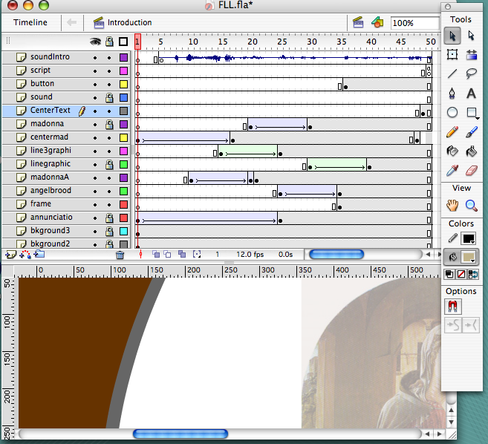
FLASH DEVELOPMENT SCREEN
Timeline
Keyframes and tweened sequence.
Frame one on the timeline
Development Tools
Layers contain individual elements arranged in a stacking order of background on the bottom to sound on the top layer.

Slide 14
PROGRAMMED ANIMATION
Animators write commands and the computer generates the animation.
Requires knowledge of programming and mathematical techniques to specify motion.
Advantages:
File sizes are smaller.
Animations load and play faster.
Reduces bandwidth and processor demands.
Efficient creation of different versions of animated sequence.

Slide 15
PROGRAMMED ANIMATION
Supports complex forms of interactivity.
Computer games take input from the user and animate the objects "on the fly."
Scripting languages frequently used to generate programmed animations:
Lingo
Actionscript
Javascript.

Slide 16
3-D ANIMATION
Elements of 3-D animation set in motion include:
Objects
Sounds
Cameras
Lights.
Techniques are similar to 2-D animation:
Key frame
Tween motion.
Complex motion may involve using models of humans and animals.

Slide 17
MOTION CAPTURE
Also called performance animation.
Technique of recording motion of actual objects and mapping these motions to a computer-generated animated character.
Performers have sensors to track the motion of various body parts as they create the action sequences.
Used to capture complex natural motions that are difficult to create.
View IT
Demonstration of a motion capture animation rig from YouTube.
Notes:
Numerous demonstrations of motion capture methods are available on YouTube. It is widely used in game development so many demos are referencing video game characters.

Slide 18
ANIMATING WITH PHYSICS
Software can automatically generate motions based on properties of object and laws of physics.
Will free animators from more tedious tasks of 3-D animation and produce more realistic content.
Animators can concentrate on developing stories and characters.

Slide 19
COMPLETING THE ANIMATION
Rendering creates the final animation frames by applying:
The modeling
Surface definition
Scene composition as specified by animator.

Slide 20
RENDERING OPTIONS
Shrek 1 in 2001 used about 5 million CPU render hours.
Shrek 2 in 2004 used 10 million CPU hours
Shrek3 in 2007 used 20 million CPU hours.
Pre-render
Requires enormous processing resources and time for animated movies.
Computer carries out complex calculations to implement the object properties, lighting, camera angles and motions.
Render in real time
Computer produces animation immediately.
Used in video games and highly interactive 3-D animations.
Notes:
Source for the CPU render time:
http://www.linuxjournal.com/article/9653
Students can research the size of render farms for popular animations from Pixar and Dreamworks to appreciate the number of computers required to compile the complex animation into a single digital film.

