Slide 1
CHAPTER SEVEN
SOUND

Slide 2
DIGITAL SOUND
Two major types of digital sound:
Sampled sound: digital recording of previously existing analog sound wave.
File contains numeric values to describe the amplitude of the sound wave at a particular instant.
Used to capture and edit naturally-occurring sounds.
Synthesized sound: new sound generated by the computer.
File contains instructions the computer uses to reproduce the sound.
Used to:
Create original compositions
Produce novel sound effects.

Slide 3
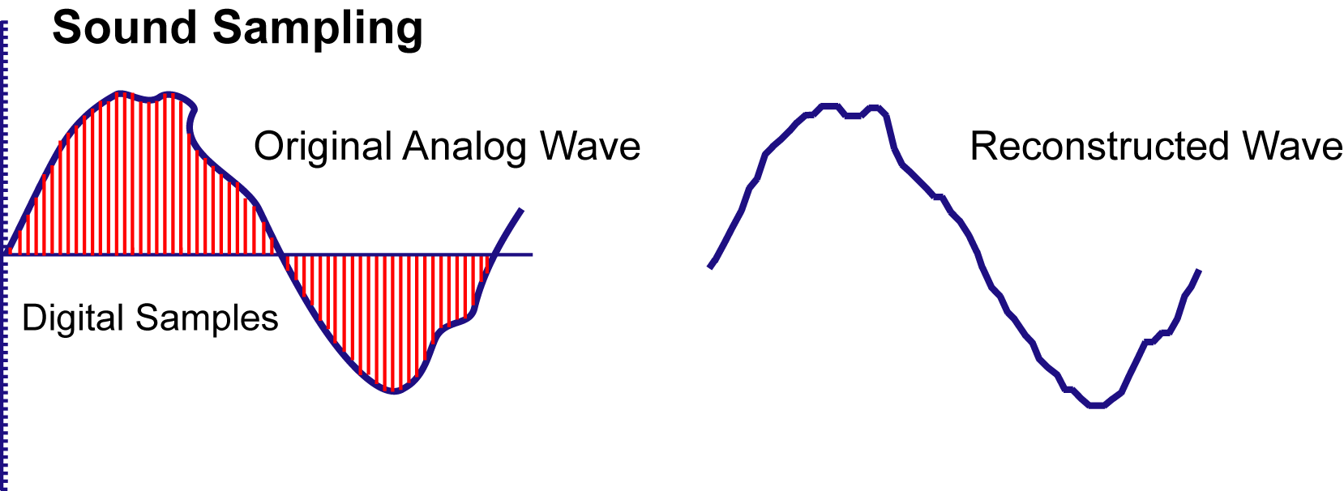
SAMPLED SOUND
Analog to Digital Converter captures separate measures of sound amplitude.
Samples are recorded as digital numbers.
Digital values are used to recreate the analog form using a Digital to Analog Converter.
Quality of the sampling depends on:
Sample resolution
Sample rate.

Slide 4
SAMPLE RESOLUTION
Number of bits to encode amplitude.
Sample resolutions range from 8-bit to 24-bit.
8-bit resolution captures 256 different amplitude levels.
Adequate for limited decibel range.
16-bit CD quality sound has 65,000 different levels.
24-bit DVD audio can generate over 16 million different levels.

Slide 5
SAMPLE RATE
Number of samples taken in a fixed interval of time.
Stated in thousands of Hertz, or kilohertz.
Determines the range of frequencies that can be represented in a digital recording.
Two measurements capture each cycle of the sound wave:
High value or peak
Low value or trough.
CD-quality sound captures 44.1kHz to record frequencies as high as 22.05kHz.
Highest frequency the human ear can detect is 20kHz.

Slide 6
SOUND COMPRESSION
Compression is best strategy to lower file size for sounds with wide range of frequencies and amplitudes.
Lossy codecs use various techniques to reduce sound file sizes.
Psychoacoustics: eliminates frequencies indistinguishable to the human ear.
Variable bitrate encoding (VBR): alters the number of bits to encode the sample depending on the complexity of the sound.
Notes:
Compression strategies are both lossless and lossy. Have students comment on why lossless strategy is not used in sound, but is critical for text compression.

Slide 7
SYNTHESIZED SOUND
Computer sends commands to specialized electronic device called a synthesizer.
MIDI (Musical Instrument Digital Interface).
Most common standard to code commands for synthesizers.
Codes provided for:
Specific instruments
Notes
Force and duration of note
Routing commands to different instrument channels
Specialized control functions.

Slide 8
DELIVERING DIGITAL SOUNDS
Downloaded audio transfers the complete audio file from the server to the client.
File remains on client computer for replay and editing.
Progressive downloads: file is saved to client computer, but begins to play from RAM as it is downloading.
Streaming audio: real-time sound that is played as it is being delivered. Not saved on client computer.
Requires special protocols, special servers, special media formats and players.
Notes:
Discuss benefits and drawbacks of each technique. Note particularly the copyright issues with each. Have students identify methods used by iTunes, a live concern of a band, a song shared on peer to peer networking.

