Slide 1
Fruits
Apple
Orange
Banana

Slide 2
Apple Blank

Slide 3
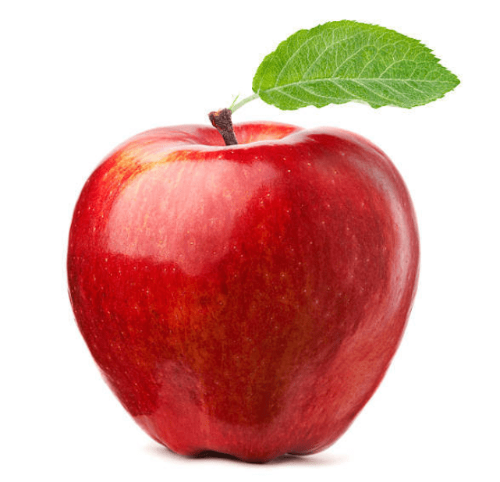
Apple

Slide 4
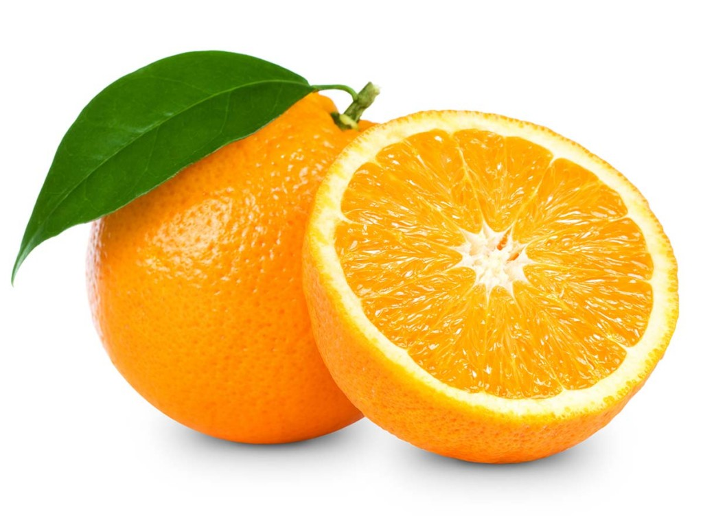
Orange

Slide 5
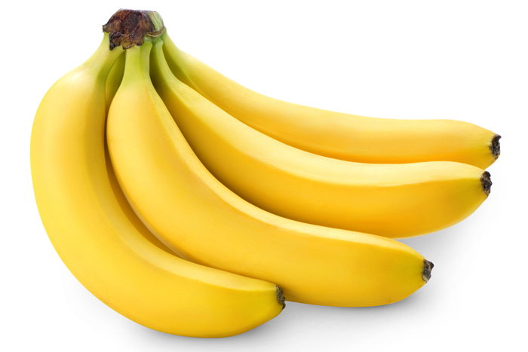
Banana

