Slide 1
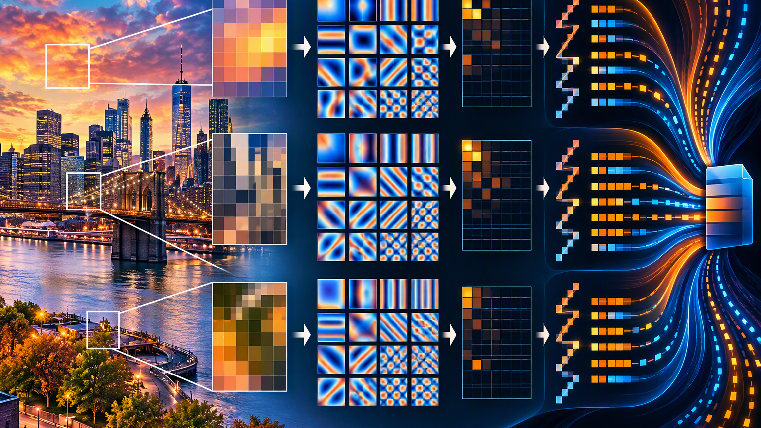
How JPEG Compression Works
From RGB pixels to 8 × 8 cosine patterns
CISC 3630
Notes:
[Sources]
- Visual on this slide was generated with Microsoft Copilot.

Slide 2
The JPEG idea
Follow one block from pixels to a compact description.
RGB
YCbCr
8 × 8
64 patterns
Quantize
Encode
pixels
light + color
one block
measure
discard
compress
The DCT measures patterns. Quantization removes precision. Coding stores the result efficiently.
Notes:
[Sources]
- https://cs.stanford.edu/people/eroberts/courses/soco/projects/data-compression/lossy/jpeg/dct.htm
- https://cs.stanford.edu/people/eroberts/courses/soco/projects/data-compression/lossy/jpeg/coeff.htm
- https://aitumik.github.io/posts/jpeg-encoder-part-1/

Slide 3
Step 1: Separate brightness from color
Keep the first explanation simple.
A red pixel
Y
Cb
Cr
YCbCr
Y ≈ 76
Cb ≈ 85
Cr ≈ 255
RGB
255, 0, 0
Brightness and visible detail
Blue-related color information
Red-related color information
High Cr indicates strong red.
Y carries the picture’s light and detail. Cb and Cr carry its color.
Notes:
[Sources]
- https://aitumik.github.io/posts/jpeg-encoder-part-1/

Slide 4
Step 2: Choose one 8 × 8 Y block
Each number is one brightness sample.
92
94
96
99
102
104
106
108
This block changes smoothly from darker to brighter.
93
95
98
101
104
107
109
111
94
97
100
104
108
112
114
116
Question for the class:
96
99
103
108
114
119
121
123
Can 64 brightness values be described using a small number of visual patterns?
98
102
107
114
122
128
130
132
100
105
111
119
128
136
139
141
102
107
114
123
133
142
146
149
8 × 8 = 64 values, not 64 bits
104
110
117
127
138
148
153
157
64 Y values
Notes:
[Sources]
- https://aitumik.github.io/posts/jpeg-encoder-part-1/

Slide 5
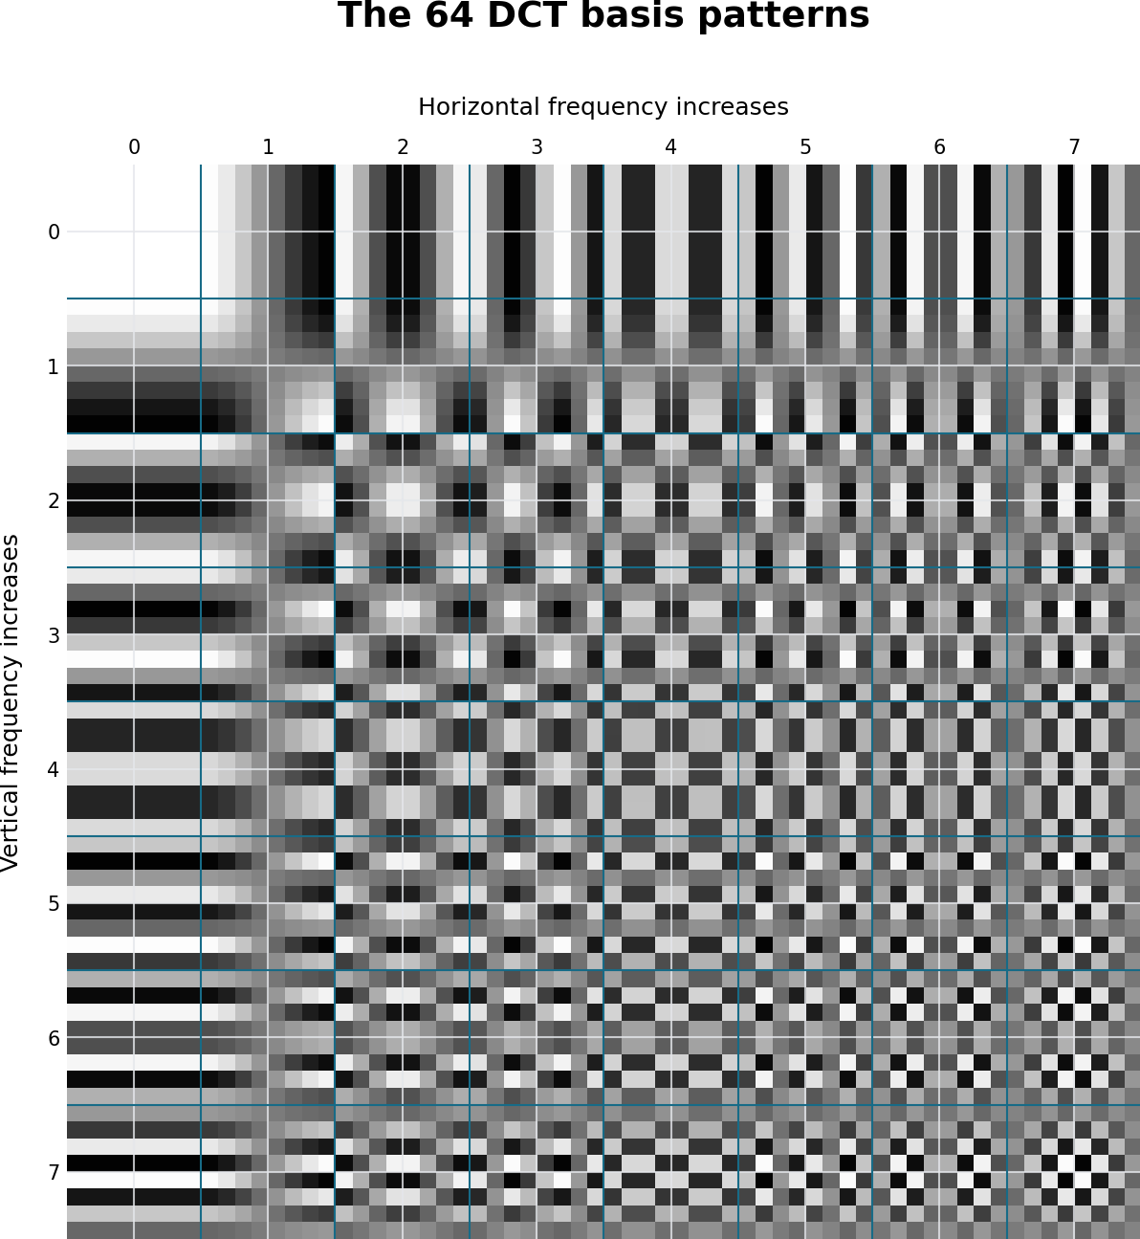
Step 3: Meet the 64 DCT cosine patterns
Every coefficient position corresponds to one pattern.
How to read the gallery
• Upper-left: constant shade
• Move right: faster left-right change
• Move down: faster top-bottom change
• Lower-right: finest combined changes
JPEG asks: “How much of each pattern is present in this block?”
Notes:
[Sources]
- https://cs.stanford.edu/people/eroberts/courses/soco/projects/data-compression/lossy/jpeg/dct.htm

Slide 6
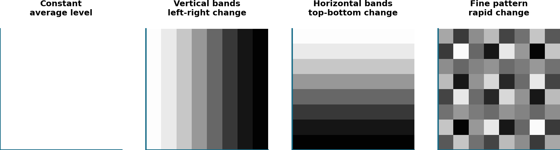
The DCT describes the block as a mixture of patterns
A coefficient is the strength of one pattern.
Strong constant pattern
+
some broad changes
+
little fine detail
=
the original 8 × 8 block
The transform is reversible in principle; it changes the representation, not the information.
Notes:
[Sources]
- https://cs.stanford.edu/people/eroberts/courses/soco/projects/data-compression/lossy/jpeg/dct.htm

Slide 7
Step 4: Apply the DCT
The result is 64 pattern strengths, not 64 pixels.
-108
-92
-6
1
-1
-2
1
-1
Large coefficient = strong pattern
Small coefficient = weak pattern
Zero = pattern not needed
-88
38
3
-2
1
1
0
0
7
-3
1
-1
0
0
0
0
-2
1
-1
1
0
0
0
0
2
-1
0
0
0
0
0
0
Upper-left DC coefficient:
average level after JPEG’s level shift
-2
1
0
0
0
0
0
0
Same positions
1
0
0
0
0
0
0
0
0
0
0
0
0
0
0
0
DCT reorganizes. It does not intentionally discard information.
Notes:
[Sources]
- https://cs.stanford.edu/people/eroberts/courses/soco/projects/data-compression/lossy/jpeg/dct.htm
- https://aitumik.github.io/posts/jpeg-encoder-part-1/

Slide 8
Step 5: Quantize the coefficients
Divide each DCT coefficient by the quantization value in the same position, then round.
16
11
10
16
24
40
51
61
Example 1: the first, upper-left coefficient
12
12
14
19
26
58
60
55
-108 ÷ 16 = -6.75 → round to -7
14
13
16
24
40
57
69
56
The strong DC coefficient survives, but its precision changes slightly.
14
17
22
29
51
87
80
62
18
22
37
56
68
109
103
77
Example 2: a weak coefficient
24
35
55
64
81
104
113
92
1 ÷ 16 = 0.0625 → round to 0
49
64
78
87
103
121
120
101
The weak pattern disappears.
72
92
95
98
112
100
103
99
Quantization keeps strong patterns approximately and removes many weak patterns.
Quantization table
Notes:
[Sources]
- https://cs.stanford.edu/people/eroberts/courses/soco/projects/data-compression/lossy/jpeg/coeff.htm

Slide 9
The quantized block contains many zeros
The exact discarded fractions cannot be recovered.
-7
-8
-1
0
0
0
0
0
-7
3
0
0
0
0
0
0
Large low-frequency values survive.
1
0
0
0
0
0
0
0
0
0
0
0
0
0
0
0
Small fine-detail values become zero.
0
0
0
0
0
0
0
0
0
0
0
0
0
0
0
0
This is where exact detail is lost.
0
0
0
0
0
0
0
0
0
0
0
0
0
0
0
0
58 of 64 coefficients are zero in this example
Notes:
[Sources]
- https://cs.stanford.edu/people/eroberts/courses/soco/projects/data-compression/lossy/jpeg/coeff.htm

Slide 10
Step 6: Zigzag turns the table into a sequence
The path moves from lower frequencies toward higher frequencies.
-7
-8
-1
0
0
0
0
0
First values from this exact block:
-7
3
0
0
0
0
0
0
-7, -8, -7, 1, 3, -1, 0, 0, 0, 0, 0, 0, 0, 0, 0, 0, 0, 0 ...
1
0
0
0
0
0
0
0
0
0
0
0
0
0
0
0
0
0
0
0
0
0
0
0
Zigzag does not discard anything. It places low-frequency values first and tends to gather long zero runs later.
0
0
0
0
0
0
0
0
0
0
0
0
0
0
0
0
0
0
0
0
0
0
0
0
Notes:
[Sources]
- https://cs.stanford.edu/people/eroberts/courses/soco/projects/data-compression/lossy/jpeg/coeff.htm

Slide 11
Step 7: Compress what remains
Run-length and Huffman coding are lossless.
Quantized values
Zigzag list
Zero runs
Huffman
Example idea
Run-length idea
-7, -7, -8, -1, 3, 0, 0, 0, 0, 0, ...
store a value, then describe the following zero run
Quantization creates zeros. Zigzag groups them. Run-length and Huffman coding store them efficiently.
Notes:
[Sources]
- https://cs.stanford.edu/people/eroberts/courses/soco/projects/data-compression/lossy/jpeg/coeff.htm

Slide 12
To display the image, reverse the process
The inverse DCT rebuilds approximate pixel values.
Decode
Undo zigzag
Dequantize
IDCT
RGB
Huffman + runs
Back to 8 × 8
Multiply
Rebuild Y/Cb/Cr
Display pixels
Why not exact?
Multiplication cannot restore fractions that quantization rounded away.
DCT + inverse DCT are reversible in principle. Quantization makes JPEG lossy.
Notes:
[Sources]
- https://cs.stanford.edu/people/eroberts/courses/soco/projects/data-compression/lossy/jpeg/dct.htm
- https://cs.stanford.edu/people/eroberts/courses/soco/projects/data-compression/lossy/jpeg/coeff.htm
- https://aitumik.github.io/posts/jpeg-encoder-part-1/

Slide 13
JPEG in one minute
The sequence students should repeat back.
Separate
Block
Measure
1
2
3
RGB → YCbCr
Choose 8 × 8
64 cosine patterns
Discard
Arrange
Compress
4
5
6
Quantize + round
Zigzag
Runs + Huffman
DCT measures patterns; quantization discards precision; coding compresses.
Notes:
[Sources]
- https://cs.stanford.edu/people/eroberts/courses/soco/projects/data-compression/lossy/jpeg/dct.htm
- https://cs.stanford.edu/people/eroberts/courses/soco/projects/data-compression/lossy/jpeg/coeff.htm
- https://aitumik.github.io/posts/jpeg-encoder-part-1/

