Slide 1
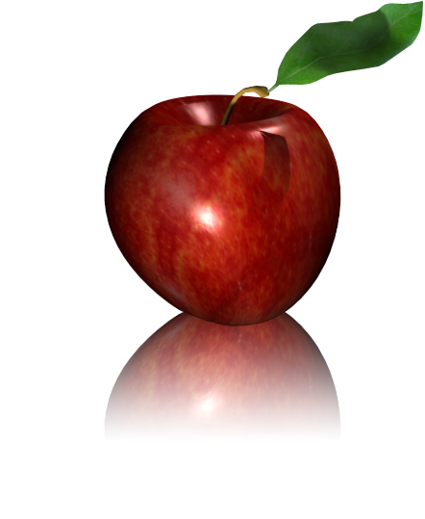
Apple

Slide 2
Orange

