Slide 1
CORC 3303 Robotics
Lawrence Goetz

Slide 2
What does a Robot mean to you?

Slide 3
What is a robot?
The word “robot” is a combination of the Czech words rabota, meaning “obligatory work” and robotnik, meaning “serf.”
Robots can do various repetitive, such as automobile assembly/inspection, as well as helpful tasks like driving a car.
Don’t limit yourself to what is currently possible mechanically or computationally as to what a robot can do. If you can imagine a robot doing something, one day a robot can do that. Perhaps you will be a designer of a futuristic robot!

Slide 4
A Robot is an autonomous system which exists in the physical world.
An autonomous robot makes its own decisions. It is not controlled by a human.
Do not confuse a remote controlled robot, which is tele-operated by a human, to be an autonomous robot.
Robots in a computer are involved in a simulated world and are therefore not true robots.

Slide 5
Robots sense their environment via various sensors. If a person supplies a robot with information manually then the robot is not fully autonomous.
Robots make their own decisions/actions and respond to sensory inputs and to achieve what is desired.

Slide 6
Robot Recap
A robot is an autonomous system which
Exists in the physical world
Can sense its environment
Can act on it to ACHIEVE SOME GOALS.

Slide 7
Control Theory
Control theory is the mathematical study of the properties of automated control systems.
Control theory is one of the foundations of engineering; it studies a vast variety of mechanical systems that are a part of our everyday lives.
We will study this later in the term dealing with Feedback control.

Slide 8
Cybernetics
Implement biological system behavior principles in simple robots, using methods from control theory.
Cybernetics is the study and comparison of communication and control processes in biological and artificial systems.

Slide 9
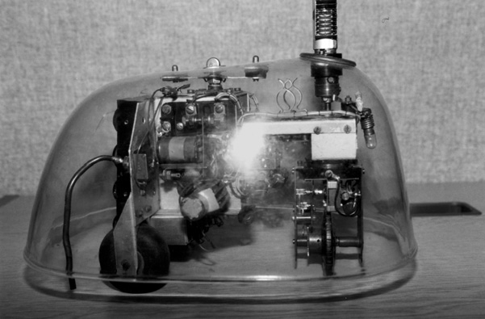
Grey Walter’s Tortoise
Biomimetic system that mimics a biological system.
Reactive control, a means of controlling robots using a collection of prioritized “reflexes.”

Slide 10
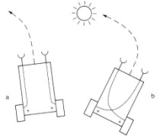
Braitenberg’s Vehicles
Braitenberg’s vehicles started out with a single motor and a single light sensor, and gradually progressed to more motors and more sensors, and more interesting connections between them.
For example, a light sensor could be connected directly to the wheels, so the stronger the light, the faster the robot moved, or even the inverse of the strength.

Slide 11
Artificial Intelligence
Intelligence in machines.
Early Examples:
Shakey
HILARE
CART

Slide 12
Robot Components
Embodiment refers to having a physical body.
Sensors supply the robot with information about it’s environment.
Effectors enable a robot to take action, to do physical things. Effectors use underlying mechanisms, such as muscles and motors, which are called actuators and which do the actual work for the robot.
Locomotion
Manipulation
Controllers take control the various parts of a robot.

Slide 13
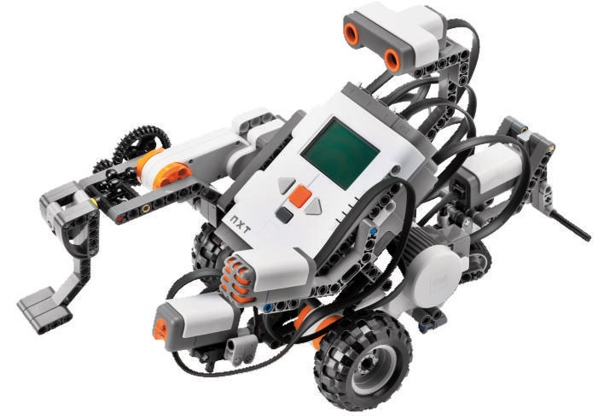
Lab
Let’s build a robot!

