Slide 1
Main Menu
Choclate
Vanilla

Slide 2
Chocolate Blank

Slide 3
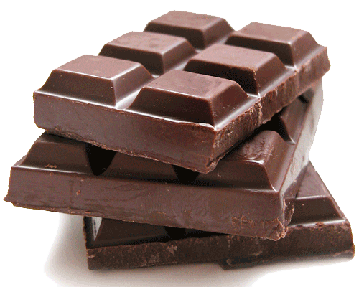
Chocolate
Yum yum yum
Delicious!!!

Slide 4
Vanilla Blank

Slide 5
Vanilla
Carvel Ice Cream!
Buy 1 get 1 free!

