Slide 1
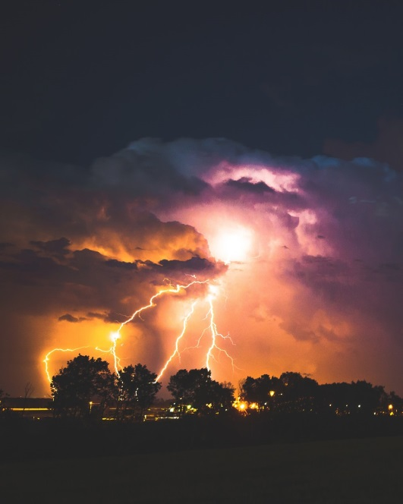
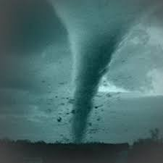
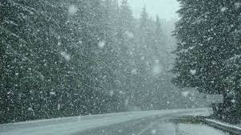
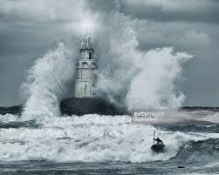
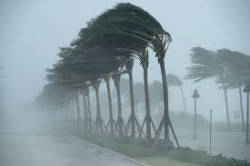
METEOROLOGY
SPRING
2019

Slide 2
Focus on the Atmosphere (2 of 4)
Meteorology, weather, and climate
Meteorology
Study of atmosphere
Weather
State of atmosphere at any given time and place
Climate
“Average weather.”
Generalized weather variation for a given place.
Climate data cannot predict weather.

Slide 3
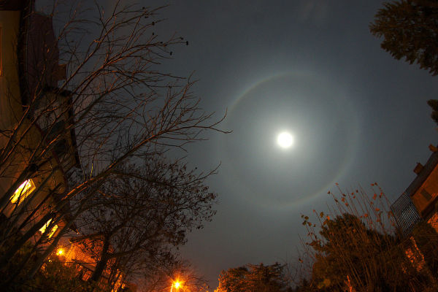
Lunar halo: An astronomical body creates a meteorological phenomenon

Slide 4
Red Sky at morning
Sailor take warning
Red sky at night
Sailor’s delight
When the wind is in the east, 'Tis neither good for man nor beast; When the wind is in the north, The skillful fisher goes not forth; When the wind is in the south, It blows the bait in the fishes' mouth; When the wind is in the west, Then 'tis at the very best.

Slide 5
The Nature of Scientific Inquiry
Scientific inquiry is a collection of facts, observations, and measurements.
Hypothesis
Explanation of facts
Test
Theory
Hypothesis that has passed many tests

Slide 6
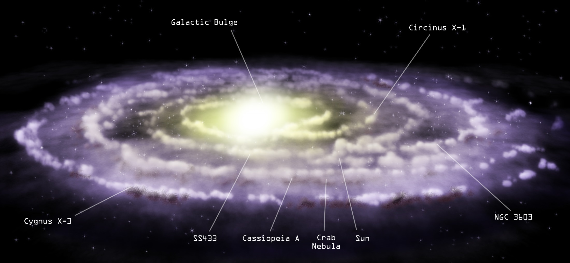

Slide 7
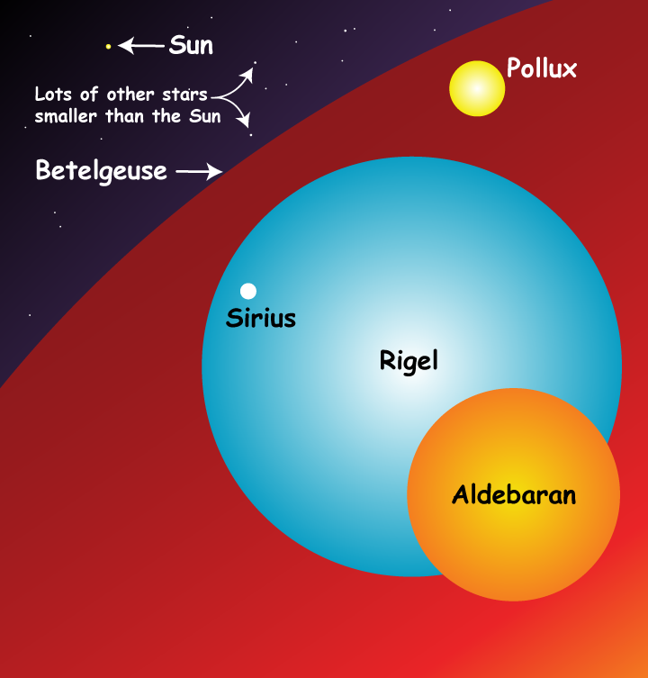

Slide 8
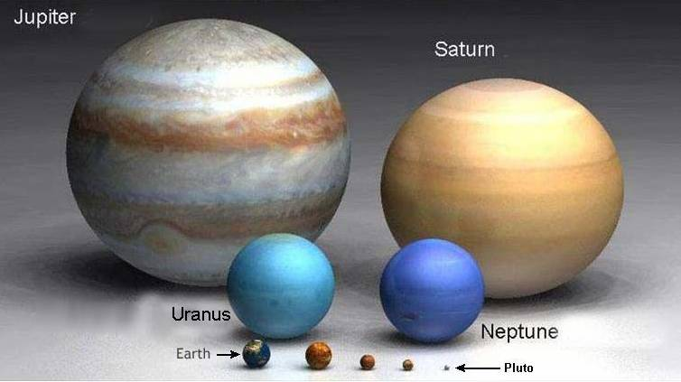
Relative sizes of the planets

Slide 9
Earth’s Spheres
The Earth is made up of four spheres.
Geosphere
Atmosphere
Hydrosphere
Biosphere
All the spheres are intertwined.
Soil is part of all four spheres.

Slide 10
Earth’s Spheres
Geosphere
The geosphere consists of the solid Earth.
It extends from the surface to the center, which is approximately 6400 km.

Slide 11
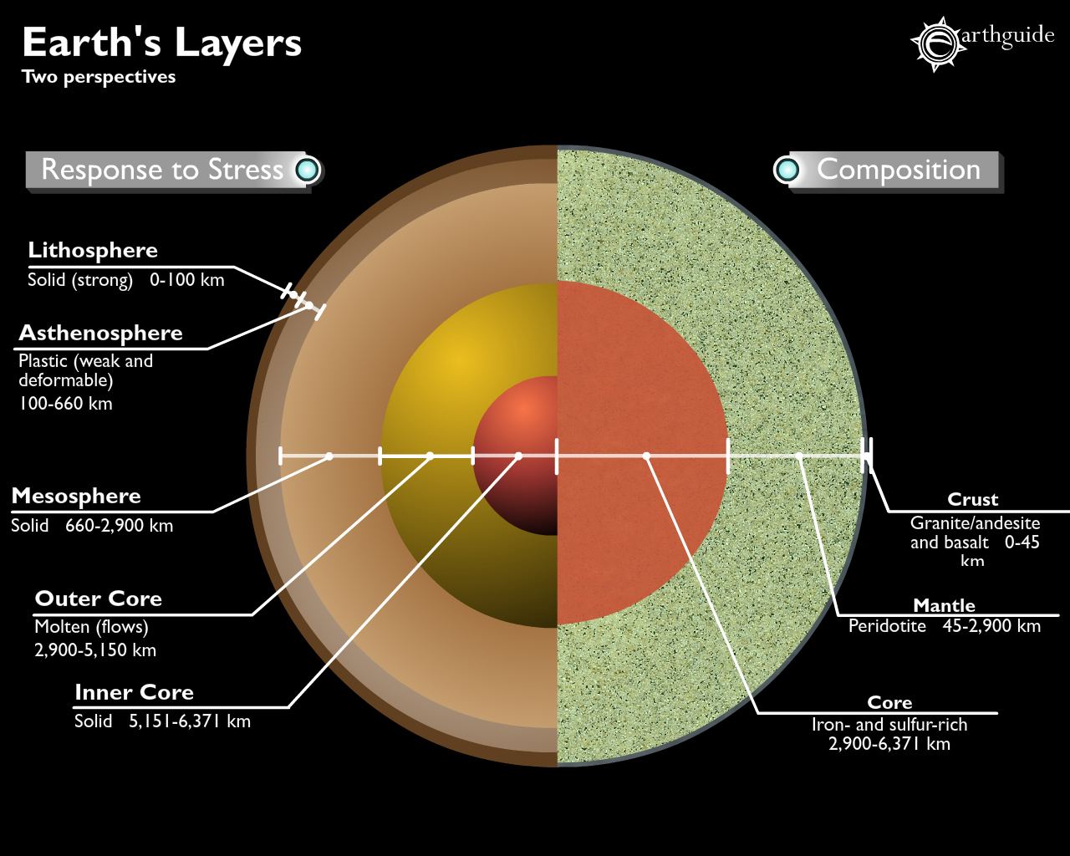

Slide 12
Earth’s Spheres
Atmosphere
99% of the atmosphere is within 30 km of Earth’s surface.
It protects the Earth.
Weather occurs in the atmosphere.

Slide 13
Earth’s Spheres (5 of 9)

Slide 14
Earth’s Spheres
Hydrosphere
Oceans make up 71% of the Earth’s surface.
Additional parts of the hydrosphere.
Lakes
Rivers, streams
Glaciers
Underground water

Slide 16
Earth’s Spheres
Biosphere
The biosphere includes all life on Earth.
On the ocean floor
In boiling hot springs
On air currents in the lower atmosphere

Slide 17
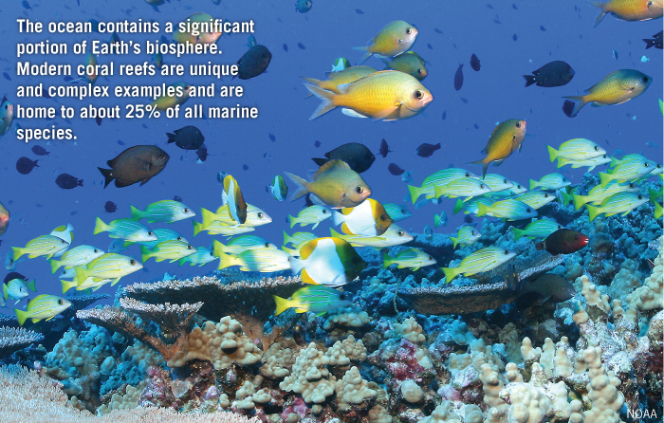
Earth’s Spheres

Slide 18
MAJOR GASES IN THE ATMOSPHERE
The Permanent Gases The Variable Gases
Nitrogen (N₂) 78.08% Water Vapor (H₂O) 0-4%
Oxygen (O₂) 20.95% Carbon dioxide (CO₂) 0.039 395 ppm
Argon (Ar) 0.93% Methane (CH₃) 0.00018 1.8 ppm
Neon (Ne) 0.0018 Nitrous oxide (N₂O) 0.00003 0.3 ppm
Helium (He) 0.0005 Ozone (O₃) 0.000004 0.04 ppm
Hydrogen (H) 0.00006 Particles (dust soot) 0.000001 0.01 – 0.15 ppm
Xenon (Xe) 0.000009 Chlorofluorocarbons 0.00000002 0.0002 ppm

Slide 19
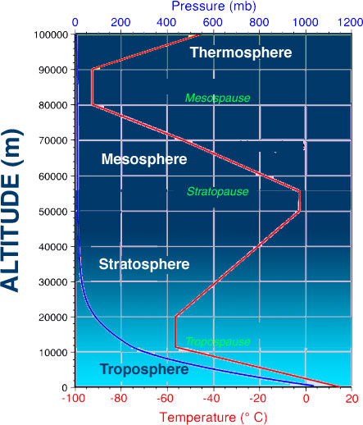

Slide 20
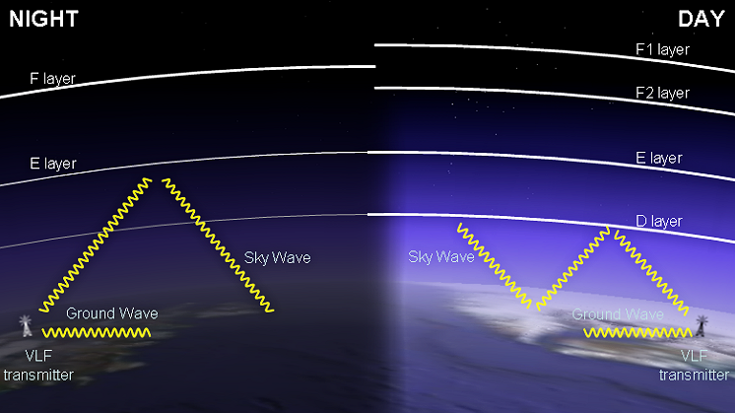
DAILY CHANGES IN THE IONOSPHERE

Slide 21
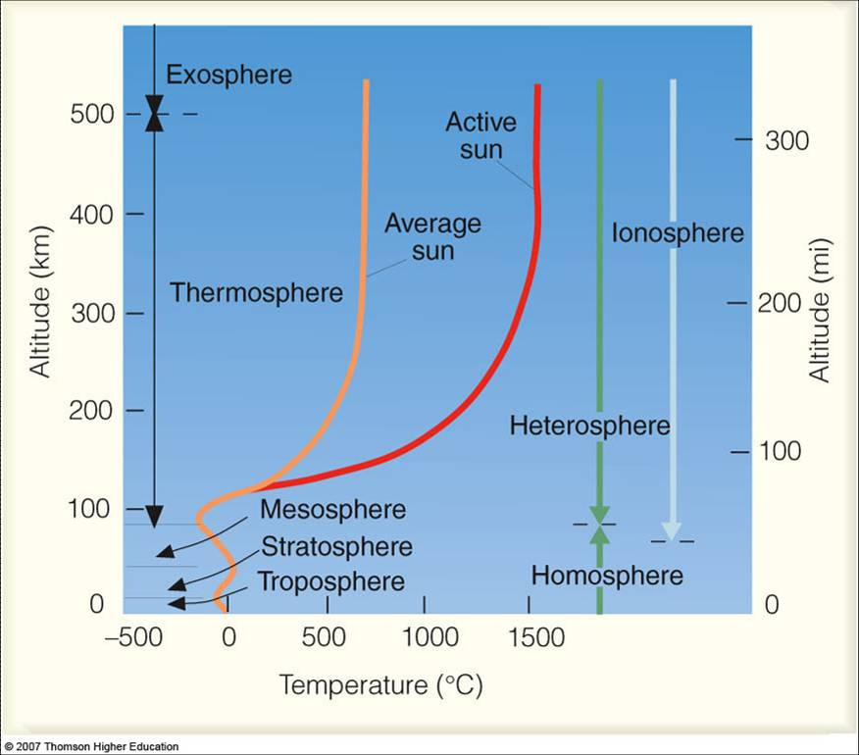

Slide 22
The atmosphere changes over time and has a long history
At one time – no free oxygen
At other times, more oxygen than now,
At this time, the permanent gases are stable and well mixed through the
heterosphere (about 60 miles up) After that they are fractionated by
their molecular weights.

Slide 23
TEMPERATURE AND HEAT
“Temperature” measures the amount of molecular movement. Higher temperatures mean more
molecular movement; cooler temperatures mean less movement.
“Heat” on the other hand is defined as “energy in the process of being transferred between
one object and the other because of the temperature difference between them.
The difference can be seen easily in the fact that a single match and a bonfire may have the
same temperature, but the bonfire has more heat than the single match.
A tub of warm water has more heat at a lower temperature than a cup of boiling water has
at a higher temperature.

Slide 24
ENVIRONMENTAL LAPSE RATE AND TEMPERATURE INVERSION
The environmental lapse rate is the rate at which the temperature decreases with
altitude. This rate varies from hour to hour and day to day. At lower regions in the
atmosphere, it averages to about 6.5 degrees C per 1000 meters or about 3.6
degrees F for every 1000 feet. On cold days the lapse rate steepens; on warmer
days the increase is slower.
A temperature inversion occurs when the air temperature may increase with height.

