Slide 1
TEMPERATURE SCALES
FAHRENHEIT
0 = FREEZING POINT OF BRINE
32 = FREEZING POINT OF PURE WATER
212 = BOILING POINT OF WATER
180 = NUMBER OF DEGREES BETWEEN FREEZING AND BOILING OF PURE WATER
CELSIUS
0 = FREEEZING POINT OF PURE WATER (NOT FOUND NATURALLY ON EARTH
-17.78 = FREEZING POINT OF BRINE
100 = BOILING POINT OF WATER
100 = NUMBER OF DEGREES BETWEEN FREEZING AND BOILING POINT OF PURE WATER
KELVIN
0 = ABSOLUTE ZERO
273.15 = FREEZING POINT OF BRINE
100 = NUMBER OF DEGREES BETWEEN FREEZING AND BOILING POINT OF PURE WATER (USES SAME SIZE DEGREE AS CELSIUS)
RANKINE
0 = ABSOLUTE ZERO
491.67 = FREEZING POINT OF BRINE
180 = NUMBER OF DEGREES BETWEEN FREEZING AND BOILING POINT OF PURE WATER
(USES SAME SIZE DEGREE AS FAHRENHEIT)

Slide 2
Triple point of water: The single combination of pressure and temperature at which liquid water, solid ice, and water vapor can coexist in a stable equilibrium

Slide 3
THE MEASUREMENT OF ENERGY (HEAT ETC.)
Temperature can be measured with at least four different scales:
Celsius
Fahrenheit
Kelvin
Rankine
How is heat measured?
There are ways of measuring “heat” one of which is the calorie. The calorie is the amount of heat it takes to raise 1 gram of water 1 degree Celsius. This is not recognized by the International System of Units.
As a form of energy (heat) has the unit joule (J) However, in many applied fields in engineering the British thermal unit (BTU) and the calorie are often used. The standard unit for the rate of heat transferred is the watt (W), defined as one joule per second.
SO WHAT IS A “JOULE”?????

Slide 4
WHAT’S A JOULE?
A joule is defined as a unit of energy equal to the work done when a force of one newton acts through a distance of one meter. It take 4.184 to equal 1 calorie.
1 Btu =1055 joules.
1 joule =0.239005736 calories
1 KJ= 1000 joule.
A newton? What’s a “newton” Is it related to a “fig newton”? Nope
Newton, the absolute unit of force in the International System of Units (SI units). It is defined as that force necessary to provide a mass of one kilogram with an acceleration of one meter per second per second. One newton is equal to a force of 100,000 dynes in the centimeter-gram-second (CGS) system, or a force of about 0.2248 pound in the foot-pound-second (English, or customary) system.

Slide 5
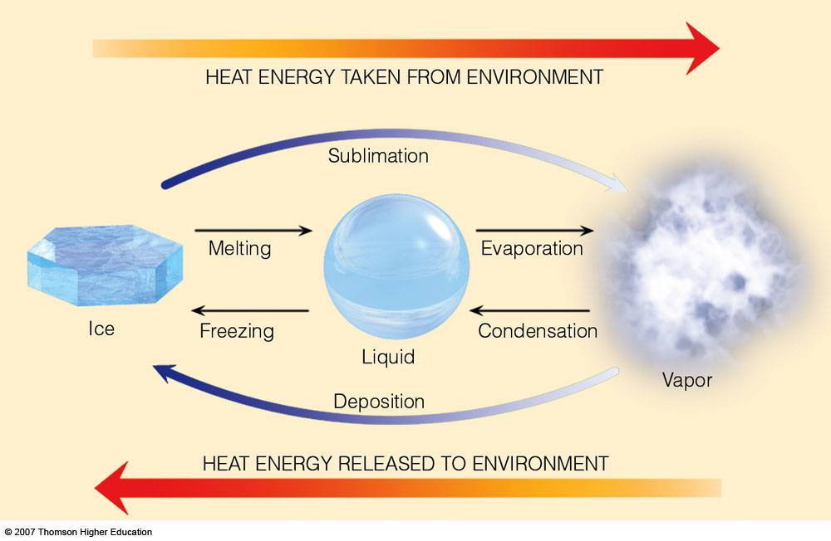
SENSIBLE AND LATENT HEAT
Sensible heat:
Can be felt and measured with a thermometer
Latent heat:
Heat that can not be measured, but is stored. The heat goes not into increasing the
speed of molecules of water, but rather into breaking the bonds between the water molecules.

Slide 6
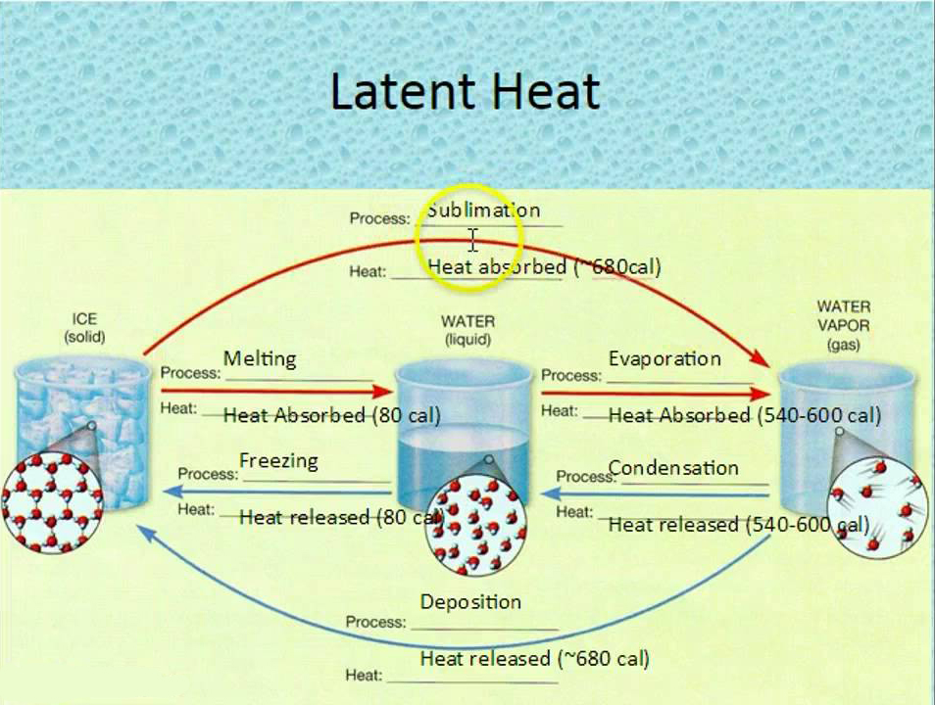

Slide 7
Kinetic energy involves movement.
It is expressed in the mathematical formula: KE= ½ mv²
m= mass
v=speed
Kinetic energy = ½ of the mass times its speed squared
If the mass and/or the speed increases the energy increases as well.

Slide 8
POTENTIAL ENERGY
Potential Energy is the second kind of energy.
Potential energy in effect is energy waiting to happen. A simple example is one in which an object is about to fall on another object. The object poised to fall contains “potential energy”
Potential energy is expressed mathematically as
PE=mgh
m=mass
g= acceleration of gravity
h = height

Slide 9
Potential energy has many forms: water behind a dam, high pressure (e.g. fire extinguishes), batteries, gasoline, explosives, firewood, and even food all have potential energy.
Kinetic energy exists in light and other forms of radiation; in heat; in moving water, in electrical power and so on.

Slide 10
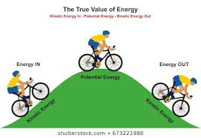
WHAT IS ENERGY?
Energy is defined as the ability or capacity to do work on some form of matter.
Generally there are two kinds of energy: “kinetic energy” and “potential energy”.
I

Slide 11
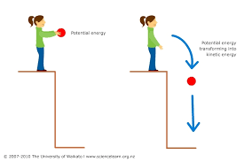

Slide 12
ACCELERATION AND SPEED
Speed has to do with how fast something is moving. Acceleration is a measurement of how rapidly the speed is increasing.
Speed is generally expressed as “miles per hour” or “kilometers per hour”
Acceleration is generally expressed as miles per hour per hour or kilometers per hour per hour.

Slide 13
NAUTICAL MILES AND KNOTS
Nautical mile: A nautical mile is about 1.15078 statute miles or
1,852 meters.
It is based on is 1/60th of a minute of arc on a meridian – a line
encircling the globe and passing through both poles – a longitude line.
Knots: A knot is a nautical mile per hour. So 10 knots is 10 nautical miles
per hour. Speed is measured in “knots”. Acceleration is “knots per hour”
A ship travel at 10 knots is traveling at 1.15 nautical miles per hour
A ship travelling at 10 knots per hour is going 10 knots faster every hour.

Slide 14
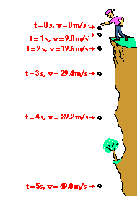
ACCELERATION OF GRAVITY
As an object falls to Earth (or any other body) its rate of speed (acceleration)
increases as it falls.
On Earth this averages about 9.807 m/s² (meters per second squared)
Time (s) | Velocity (m/s)
0 | 0
1 | - 9.8
2 | - 19.6
3 | - 29.4
4 | - 39.2
5 | - 49.0

Slide 15
WHAT ABOUT PRESSURE?
What measurement is used for pressure:
Pressure = force per area = P=F/A
P=pressure
F=force
A=area
It is measured in many ways:
Pounds per square inch
Atmospheres (ATM)
Inches or millimeters of mercury (Hg) 29.92 inches of Hg
Bars or millibars 1 bar= 14.50377 psi; 29.92 inches of mercury = 1013.203477792 millibars 10 meters of sea water = 1 bar
To convert inches of mercury to millibars, multiply the inches value by 33.8637526
To convert millibars to inches of mercury, multiply the millibar value by 0.0295301.
Pascals (Pa) Pascals = N/m² Where N=newtons and m²=square meters
1 hectopascal (hPa)=100pascals = 1 millibar. So hPa’s and millibars are the same.

Slide 16
REVIEW OF MEASUREMENTS
Temperature: Degrees (Celsius, Fahrenheit, Kelvin or Rankine
Energy (heat is one kind): Joules, Calories, British thermal units
Pressure: atmospheres (1); pounds per square inch (14.50377); millibars (1013.203477792 ) ; inches of mercury (29.92 ); meters of sea water (10); 101325 Pa
1 hectopascal=100pascals = 1 millibar
1 kilopascal=1000Pa = one centibar.
Force: Newtons. the force needed to accelerate one kilogram of mass at the rate of one meter per second squared in the direction of the applied force
Pascal = Newtons per square meter

Slide 17
THREE METHODS IN WHICH HEAT TRANSFERS OCCUR
CONDUCTION:
Heat is transferred from one area having more heat to one adjacent having less heat. Transfer is through physical contact.
CONVECTION:
Heat is carried by more active molecules in rising currents. As they rise in one place they cool and sink
RADIATION:
Electromagnetic energy emitted or absorbed by atoms

Slide 18
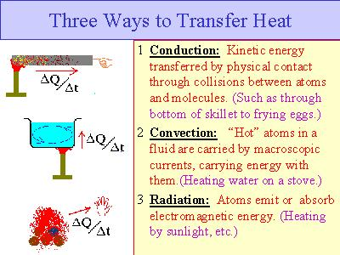

Slide 19
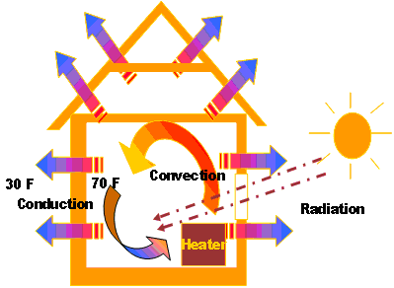
CONDUCTION
The transfer of heat by direct contact between two materials of different temperatures or
two parts of the same materials with different temperatures
Consider the exterior wall of a warm house in winter, which contacts the air outside the house.
Some of the air will start to warm as a result of the contact and the house will get cooler. This is conduction.

Slide 20
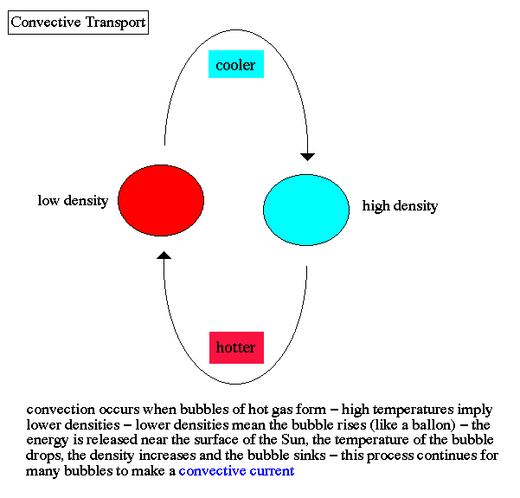
CONVECTION
As gases heat up they expand and rise. When they reach a certain height in cooler temperatures
They start to cool and become more dense and sink

Slide 21
←-----------wind------------- ------------wind------------→
| /|\ /|\ |
| | | |
| | | |
| | | |
| Convection | | Convection |
| | | |
| | | |
\|/ | | \|/
--------------wind----------→ ←---------wind--------------
-----HOT GROUND------

Slide 22
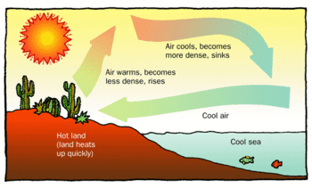

Slide 23
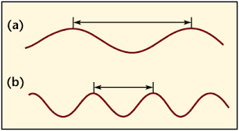
WAVELENGTHS ARE MEASURED FROM ONE CREST TO THE NEXT

Slide 24
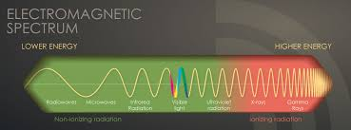
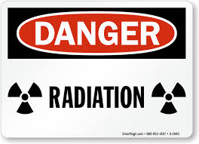
RADIATION
Radiation is he emanation of any part of the electromagnetic spectrum plus the release of particles

Slide 25
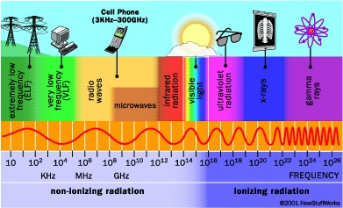

Slide 26
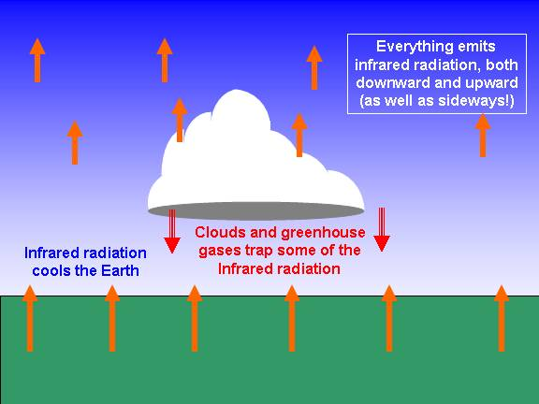

Slide 27
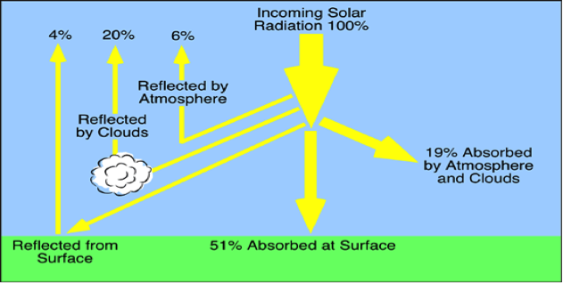

Slide 28
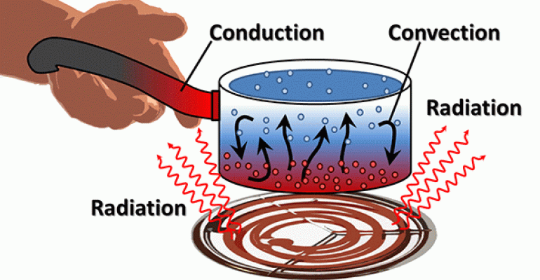

Slide 29
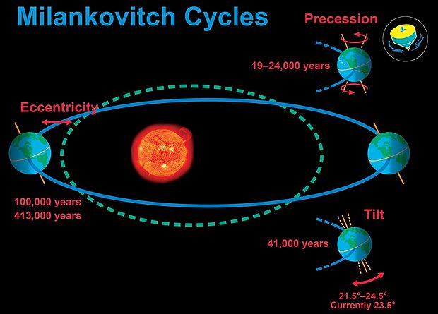

Slide 30
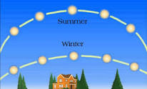
Where does the sun appear in the sky in summer and winter?

Slide 31
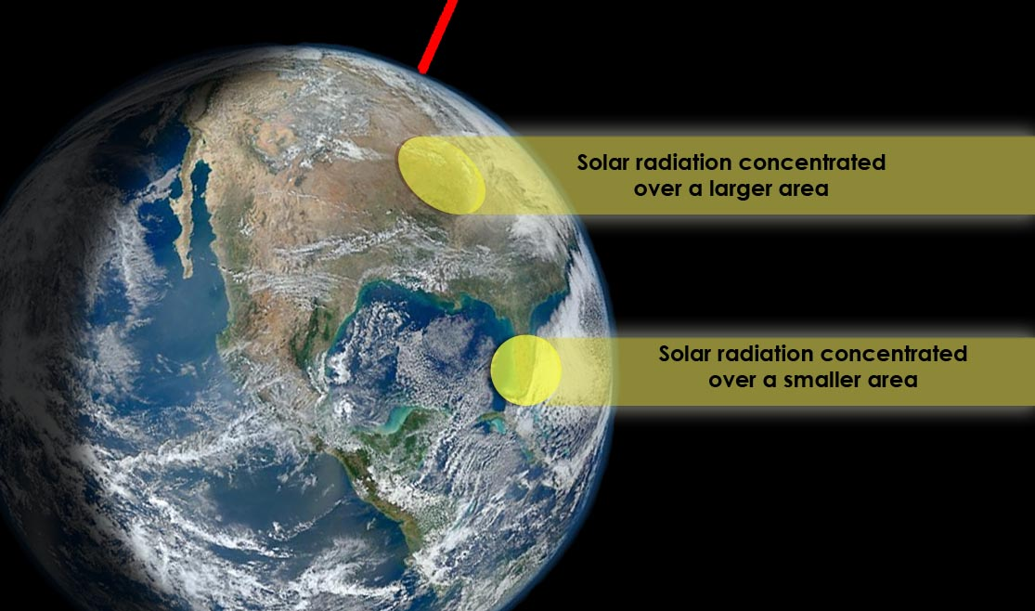

Slide 32
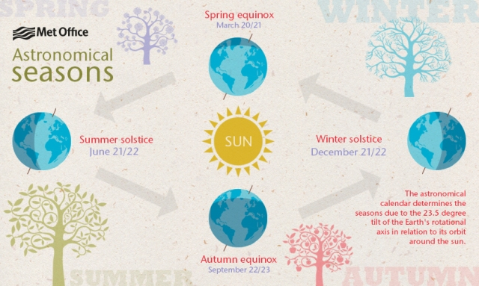
WHY WE HAVE SEASONS

Slide 33
