Slide 1
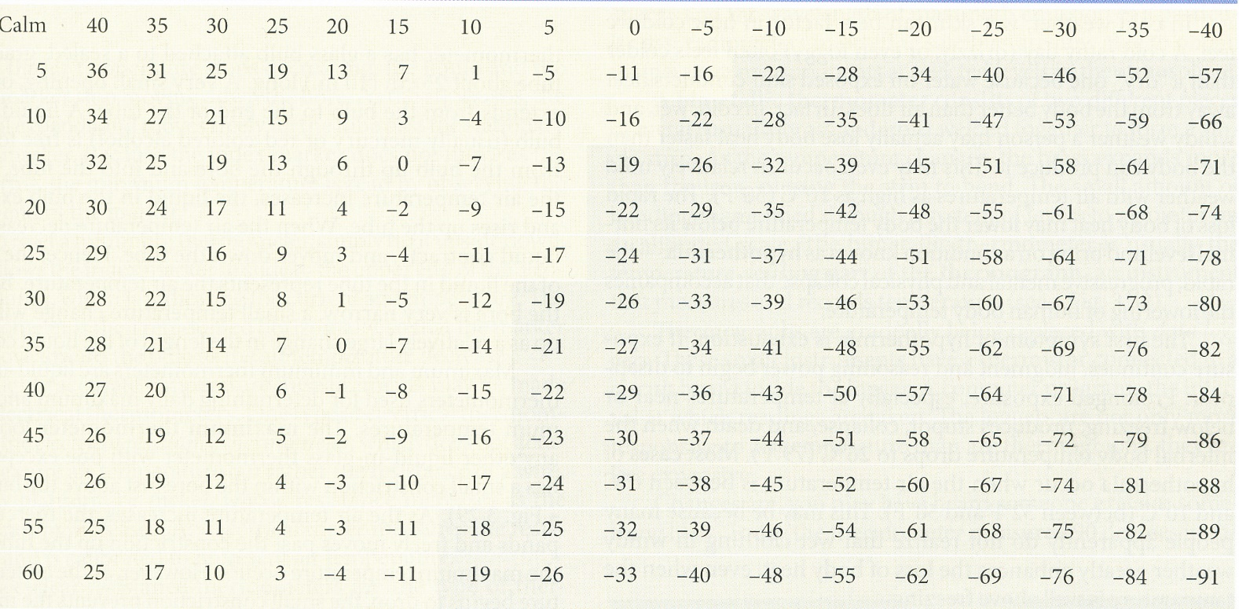

Slide 2
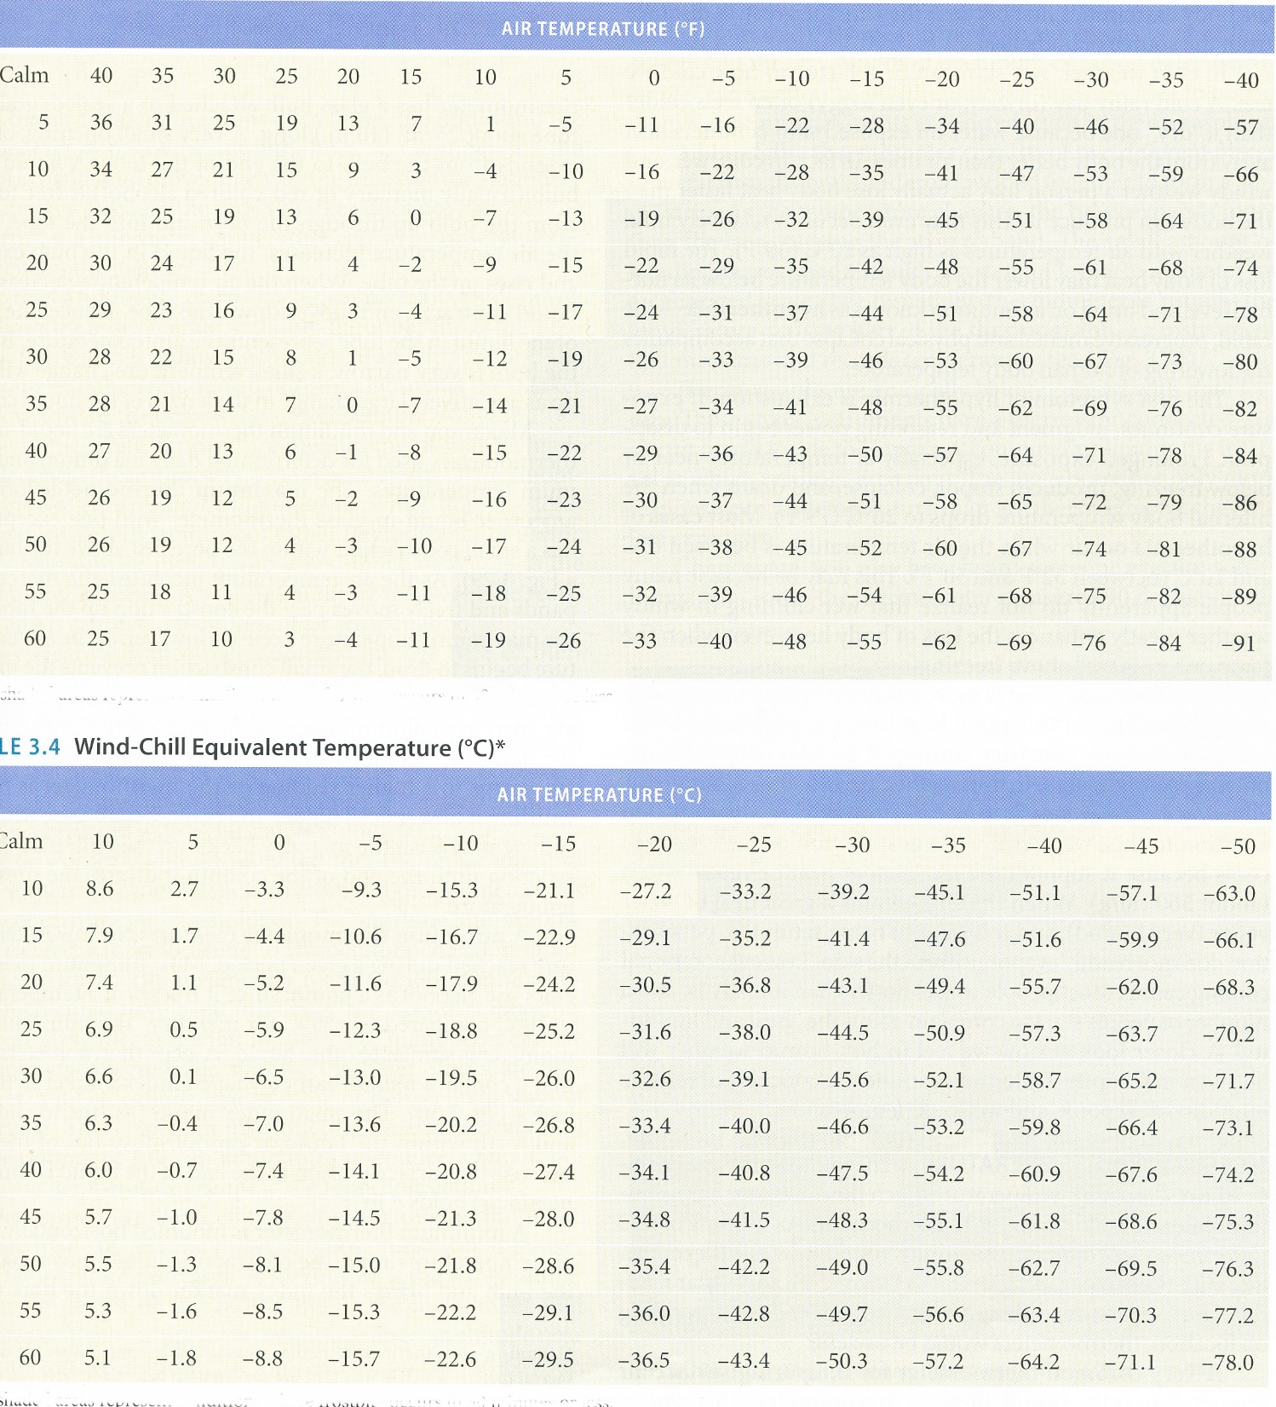

Slide 3
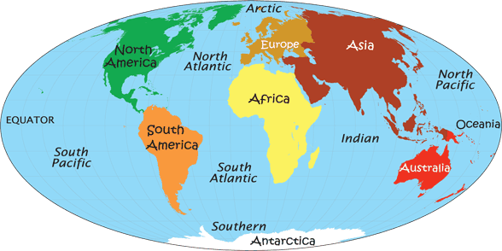
About 71% of the Surface of the Earth Is Covered with Water

Slide 4
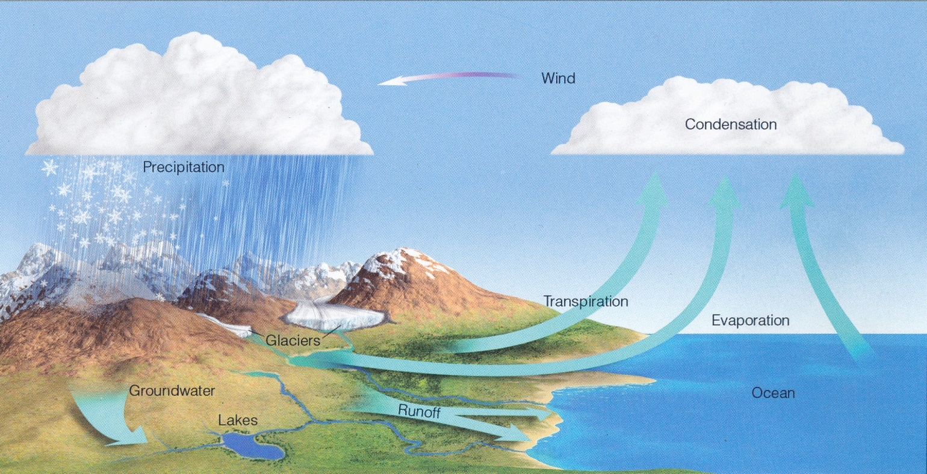

Slide 6
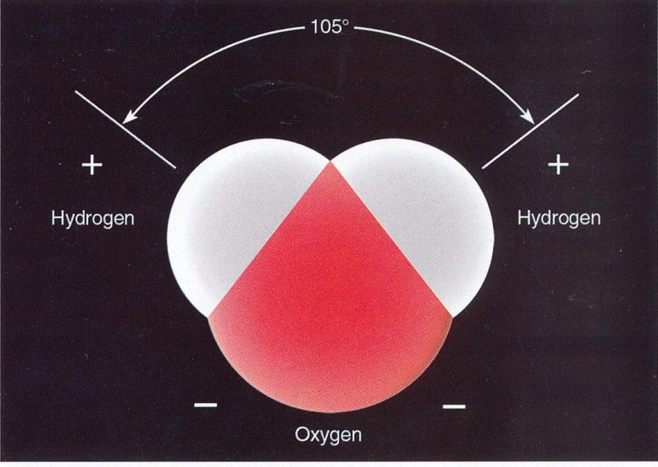
Water molecule – not really these colors

Slide 7
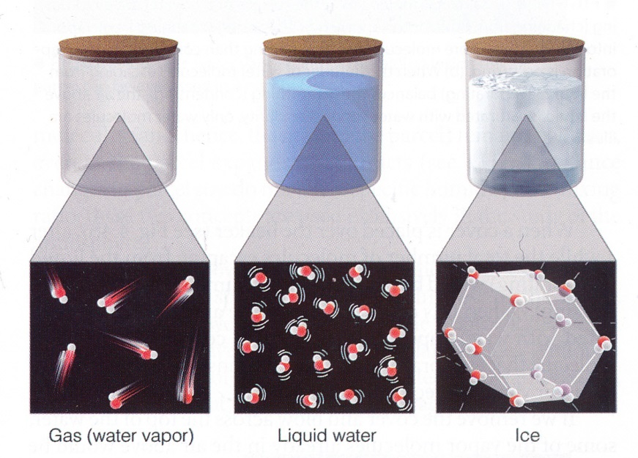

Slide 8
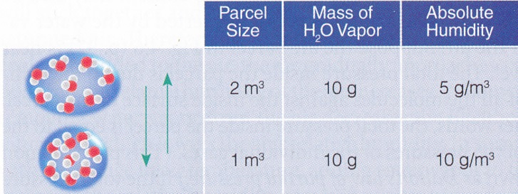

Slide 9
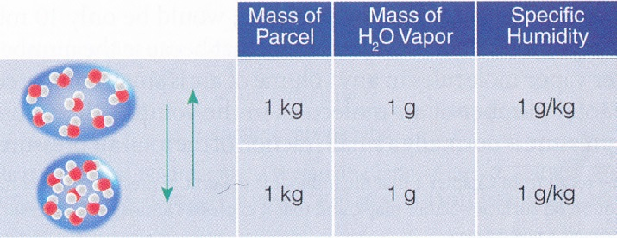
Total mass of the air = all the air including the water vapor

Slide 10
Total mass of the air is the total mass less the mass of water vapor

Slide 11
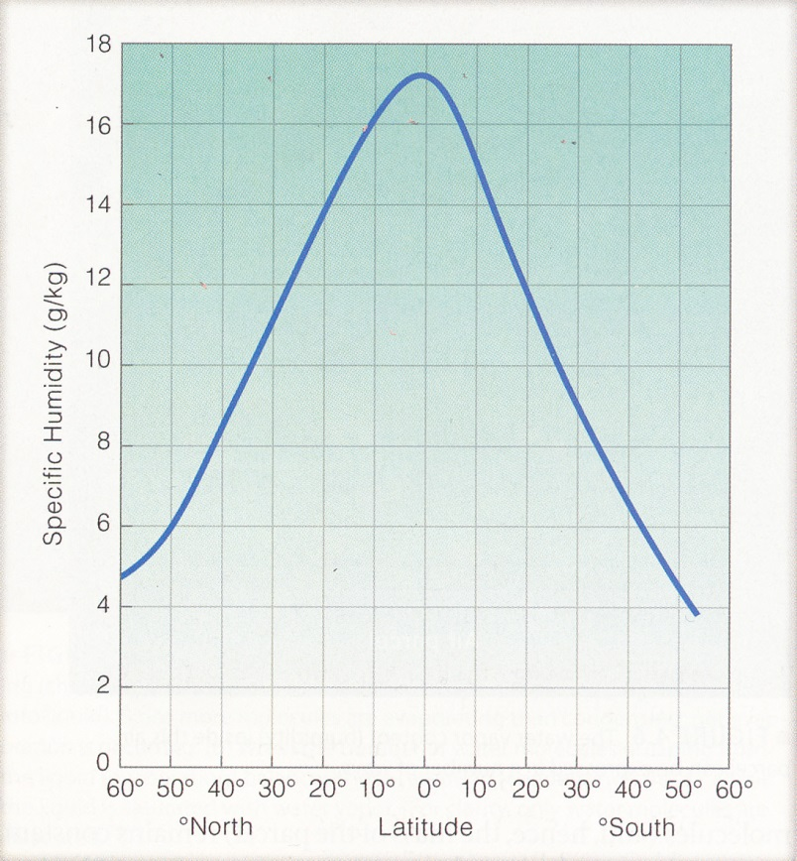

Slide 12
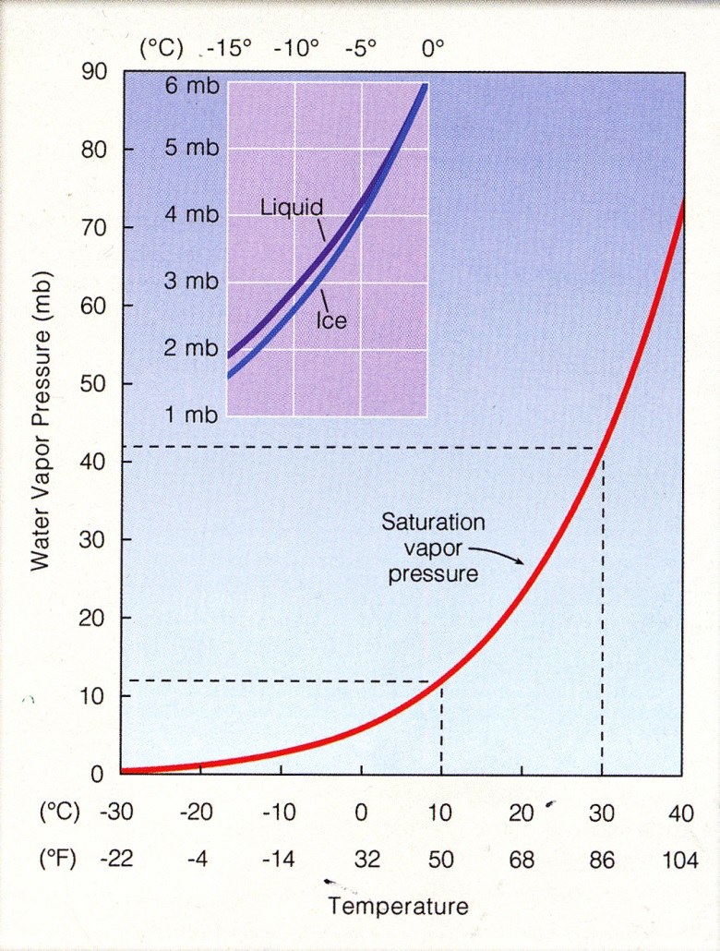
The chart shows that saturation vapor
pressure (here in mb) increases with temperature. At 10⁰C the saturation pressure us about 12 mb. At 30⁰C it is about 42 mb
The inset shows that saturation vapor pressure over water is greater than saturation vapor pressure over ice

Slide 13
or

Slide 14
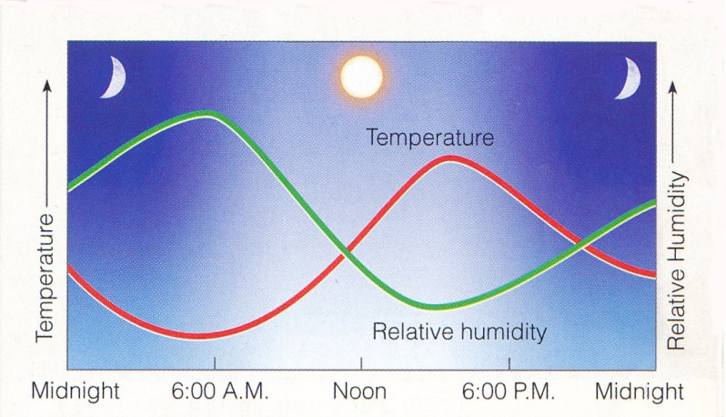
Note that the humidity varies inversely with the temperature.
Higher RH occurs with lower temperatures, while lower RH occurs
with higher temperatures.

Slide 15
PROBLEM:
WHAT HAPPENS WHEN THE TEMPERATURE WARMS FROM 10⁰C TO 30⁰C? KEEP THE FORMULA BELOW IN MIND

Slide 16
FROM THS CHART IT IS EVIDENT THAT AT 10⁰C (50⁰F) THE WATER VAPOR PRESSURE IS ABOUT 12mb

Slide 17
So we can set the equation at:
since we know the actual saturation
pressure is 12 mb and the RH is at
100%.

Slide 18
USING THE SAME LOGIC AND CHART WE CAN SET THE EQUATION FOR 30⁰C (86⁰F)
FROM THS CHART IT IS EVIDENT THAT AT 30⁰C (50⁰F) THE WATER VAPOR PRESSURE IS ABOUT 42mb

Slide 19
So we can set the equation at:
since we know the actual saturation
pressure is 42 mb and the RH is at
29%.
Notes:
So there has been in change in the RH from 100% to 29% as a result of temperature change and not the amount of water vapor in the air

Slide 20
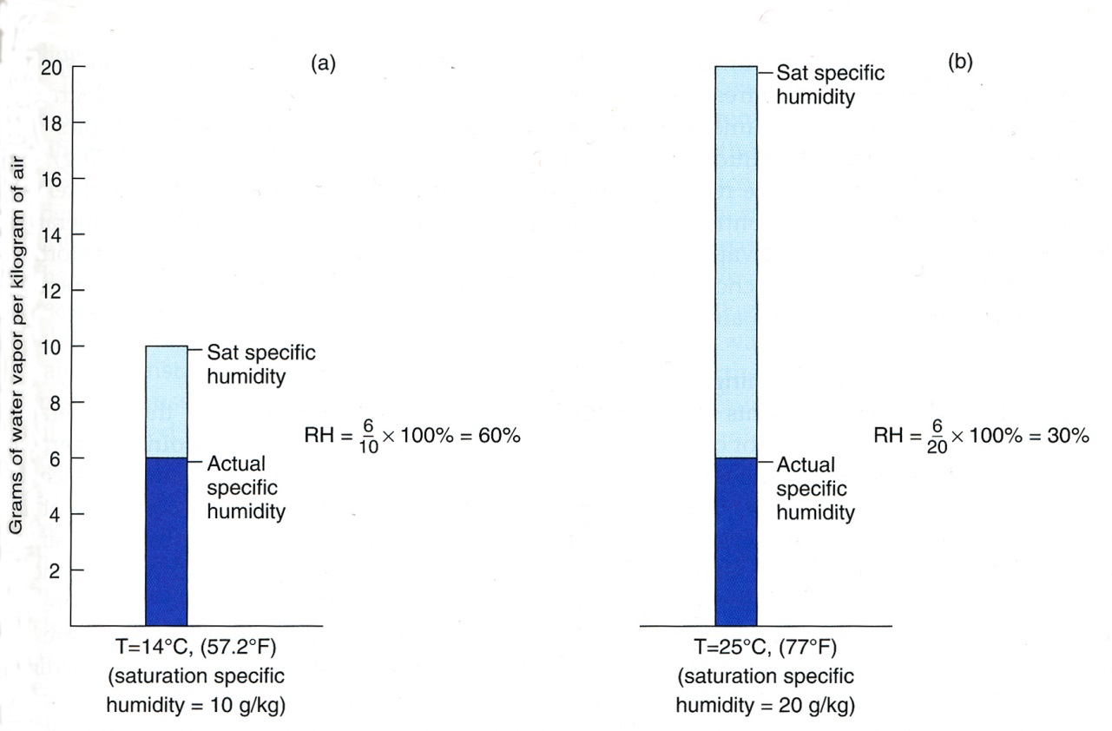
Notes:
RH=SPECIFIC HUMIDITY/SATURATION SPECIFIC HUMIDITY x 100%. (a) has a T=14⁰ C The actual SPECIFIC humidity =6; SATURATION specific = 10 FOR (b) has a temp of 25⁰ C Actual specific = 6 again, but Saturation = 20. The relativer humidity in (a) is 60% while in (b) it is 30% So the relative humidity DECREASED even though the amount of water vapor remained the same

Slide 21
TYPE | MEASURED IN
Vapor Pressure | Millibars kilopascals pascals 100 Pa = 1mb = 0.kPa
Absolute Humidity | # of grams of water vapor in a parcel of air.
Specific Humidity | # grams of water vapor per kilogram (relative to total mass)
Mixing ratio | # grams of water vapor per kilogram (relative to dry mass (total-vapor)
Relative humidity | % - specific humidity/saturation specific humidity X 100
Dew point | Degrees of temperature – temperature are which air reaches saturation

Slide 22
Absolute Humidity

Slide 23
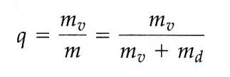
Specific Humidity
or
Mixing Ratio
or

Slide 24
RELATIVE HUMIDITY
Relative humidity

Slide 25
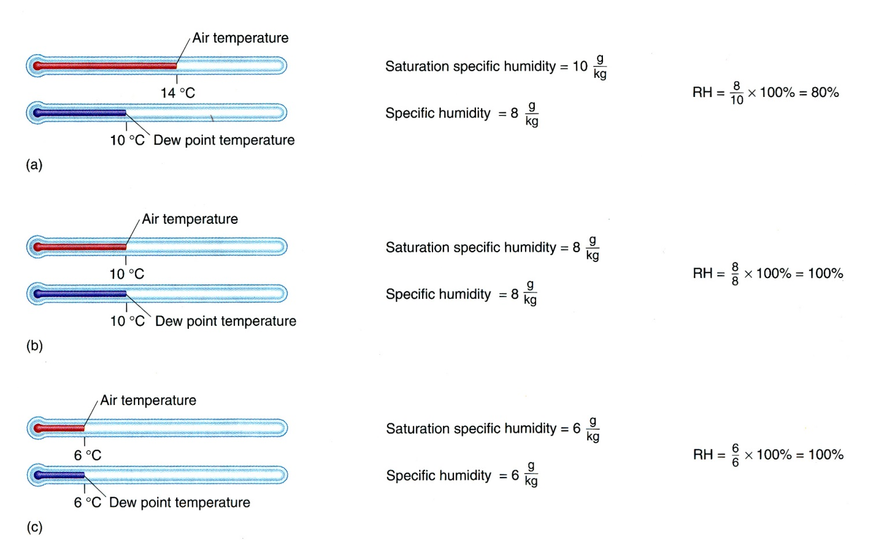
DEW POINT AND TEMPERATURE
Notes:
In (a) and (b) dew point remains the same – i.e. at 10⁰ C degrees the air becomes saturated. In (a) At 14⁰ C The RH is 80%. (b) At 10⁰ the air has fallen to the dew point and so the two are equal and the RH = 100%. (c) the temperature falls to 6^{O} C lower than the original dew point. The water vapor begins to liquefy and as a result and the dew point lowers to 60 C also. RH = 100% The dew point can NEVER be higher than the air temperature.

Slide 26
DEW POINT
The dew point the temperature to which the air must drop to reach saturation.
When the temperature drops to the dew point, some condensation will occur – usually
this is “dew”.
If the temperature is lower than freezing this will lead to deposition rather than
condensation in the form of frost.
If the temperature falls below 0⁰C (32⁰F) after the dew has condensed it becomes
frozen dew (rather than frost) rather than frost occurs when dew forms and then
freezes.
Since warmer air can hold more water than colder air, the dew point temperature
is lower than the air temperature. When the two – the air temperature and the dew
point meet, the air is saturated and can hold no more water.
As a result, the dew point is a good measure of how much water vapor is in the air and
is useful when comparing areas at different temperatures to see how much water
vapor there is the air.

Slide 27
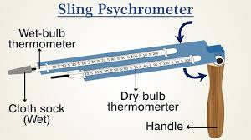
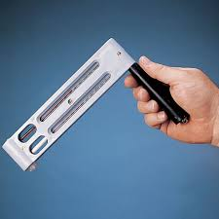

Slide 28
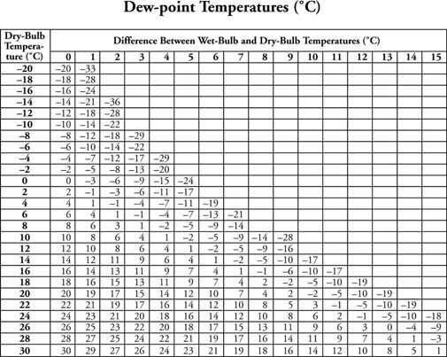

Slide 29
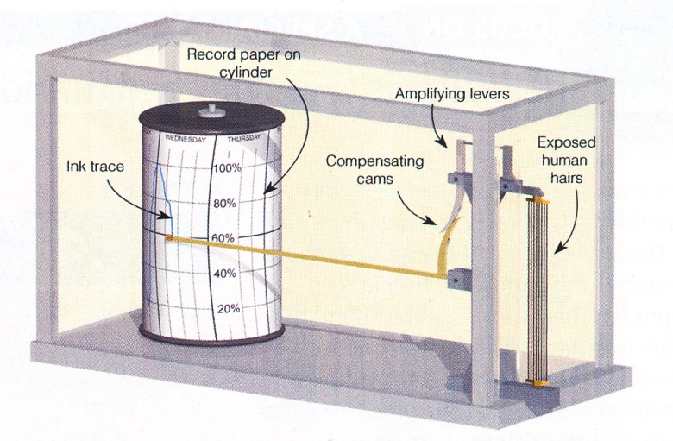
HAIR HYGROMETER

