Slide 1
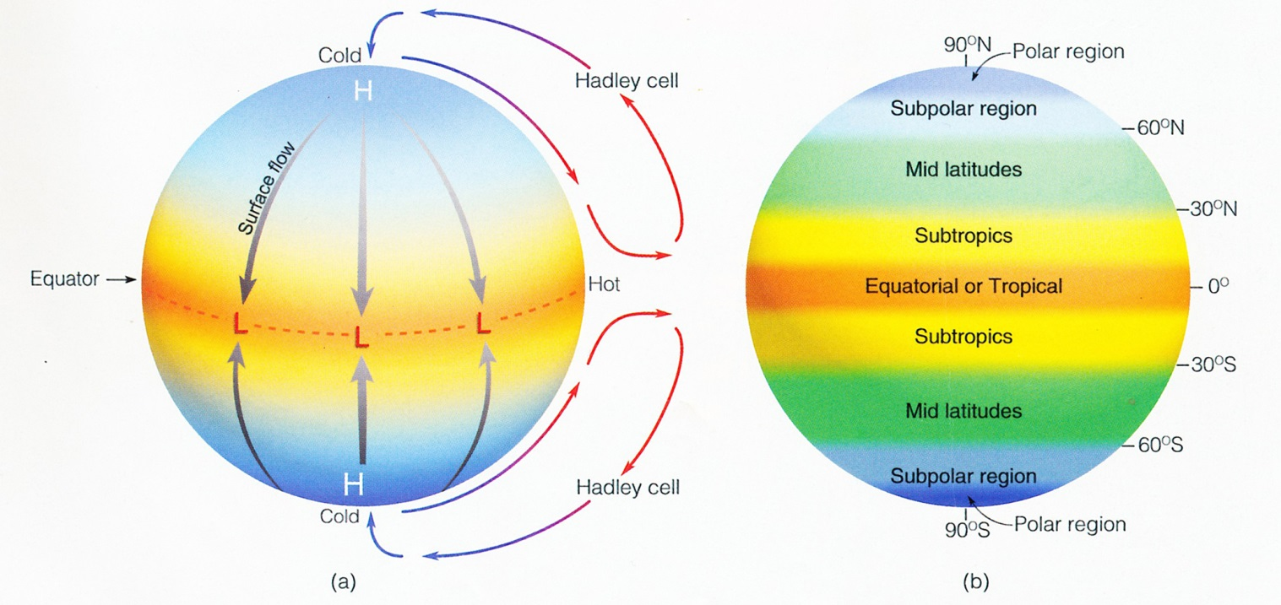
THE “ONE CELL” HADLEY MODEL
Assumptions (false, but simplifies the problem initially):
the earth is uniformly covered in water so there is no differential heating between
water and land (no differential heating between water and land)
(b) The sun is ALWAYS directly overhead at the equator (no seasonal changes)
(c) The earth does not rotate (only pressure gradient force exists)

Slide 2
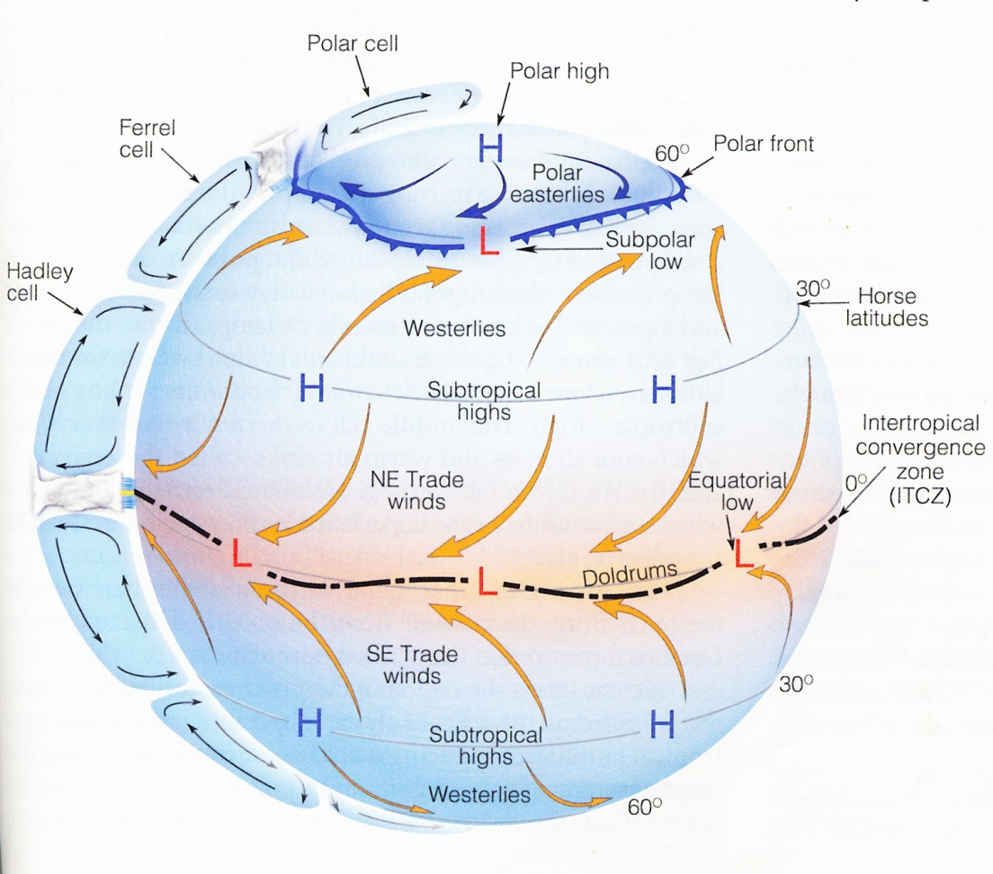
A more
complex form
with 3 cells.
This allows
for the
Earth’s
rotation and
the Coriolis
Effect

Slide 3
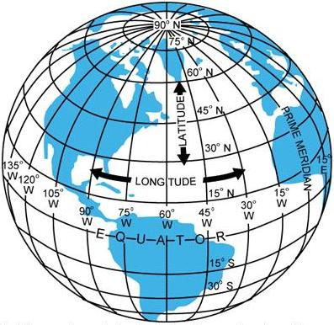
Meridians are closer
together here
⬅
than they are here
⬅
This is why the
convergences (or
piling up) causes
surface air pressure
to increase
Note that the
Distance between the
meridians decreases
as the latitude
increases

Slide 4
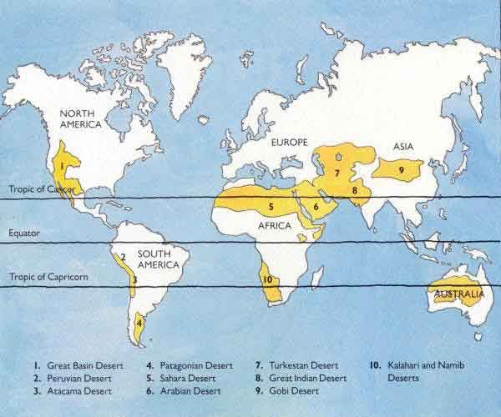

Slide 5
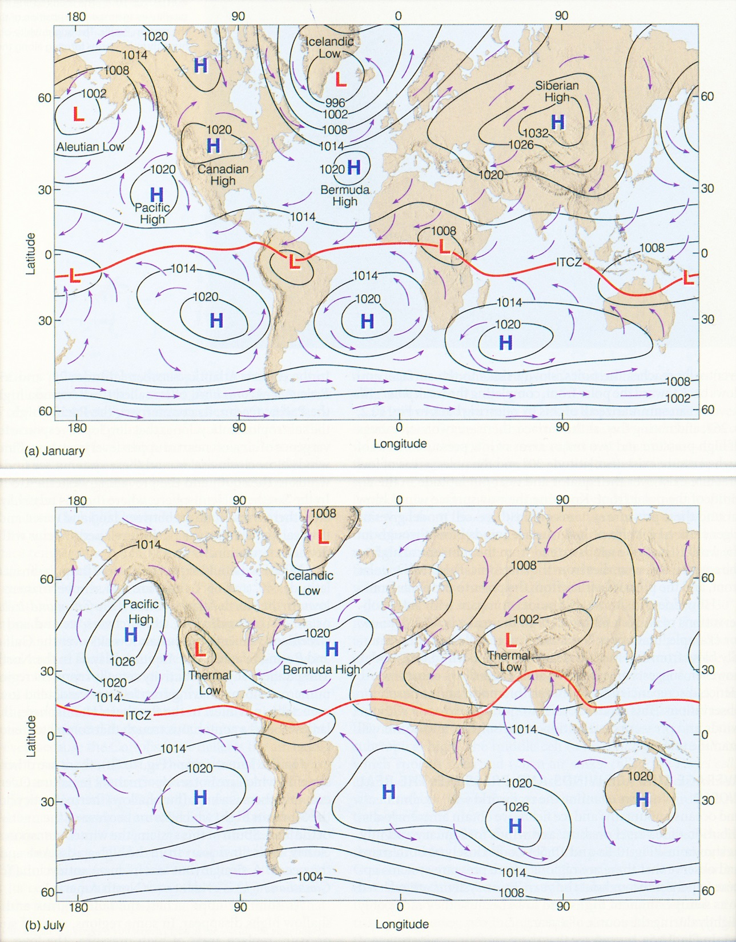

Slide 6
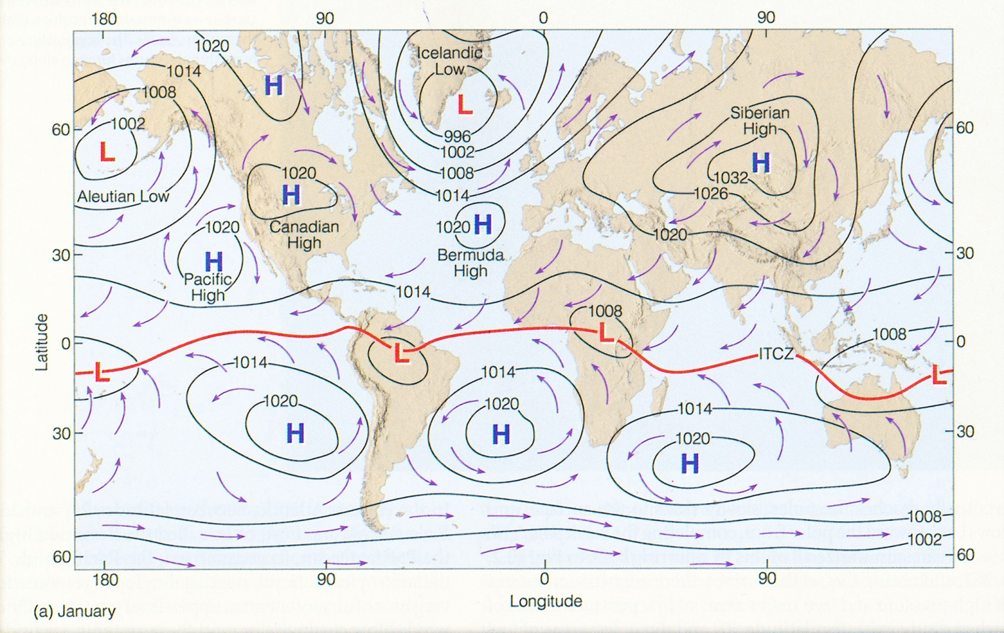
POSITIONS OF SEMIPERMANENT HIGHS AND LOWS – AND NON-SEMIPERMANENT ONES AS WELL
FOR JANUARY

Slide 7
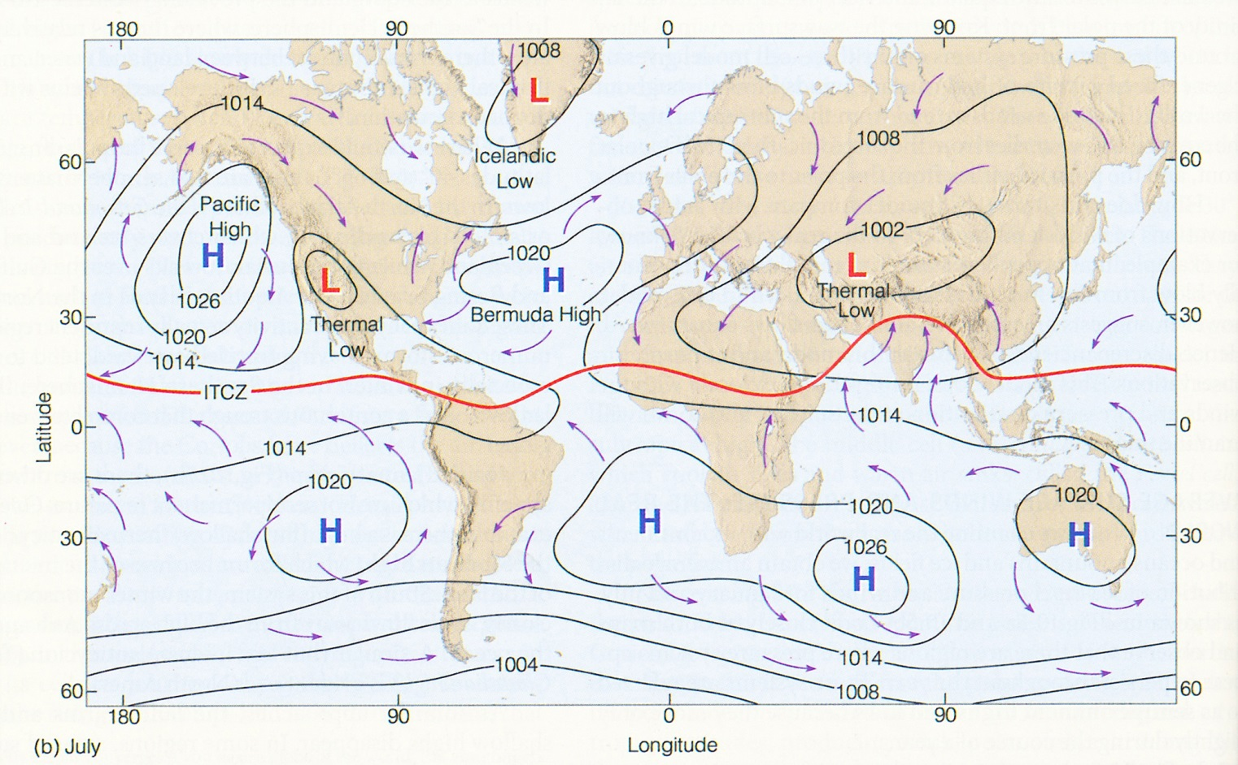
POSITIONS OF SEMIPERMANENT HIGHS AND LOWS – AND NON-SEMIPERMANENT ONES AS WELL
FOR JULY

Slide 8
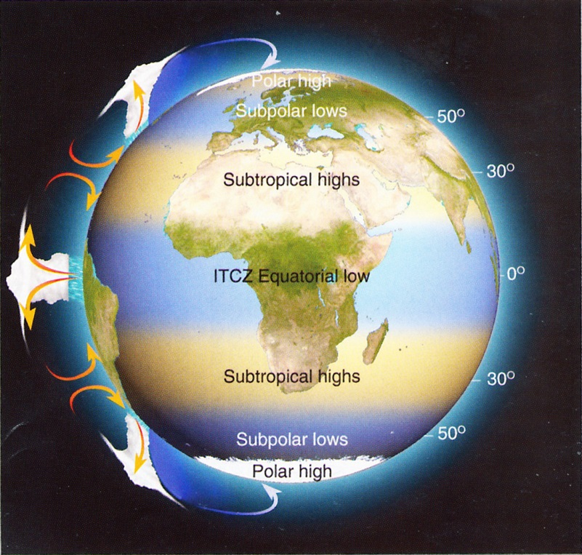
MAP SHOWING
AREAS OF RISING
AND SINKING AIR
WHERE AIR RISES
PRECIPITATION
TENDS TO OCCUR
(BLUE BANDS)
WHERE ARE SINKS
THE CLIMATE IS
DRIER.
NOTE THE
LOCATION OF THE
WORLD’S DESERTS

Slide 9
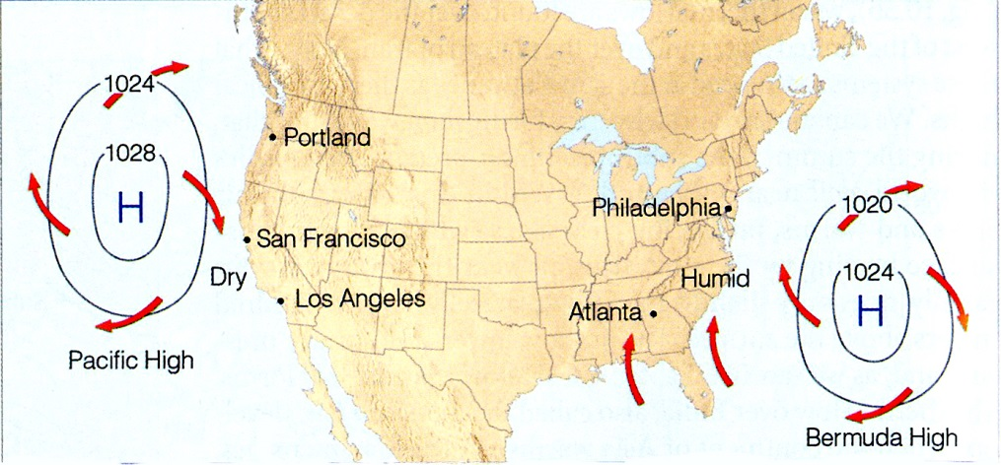
ATLANTIC AND PACIFIC COAST HIGHS HAVING DIFFERENT EFFECTS ON THE COAST

Slide 10
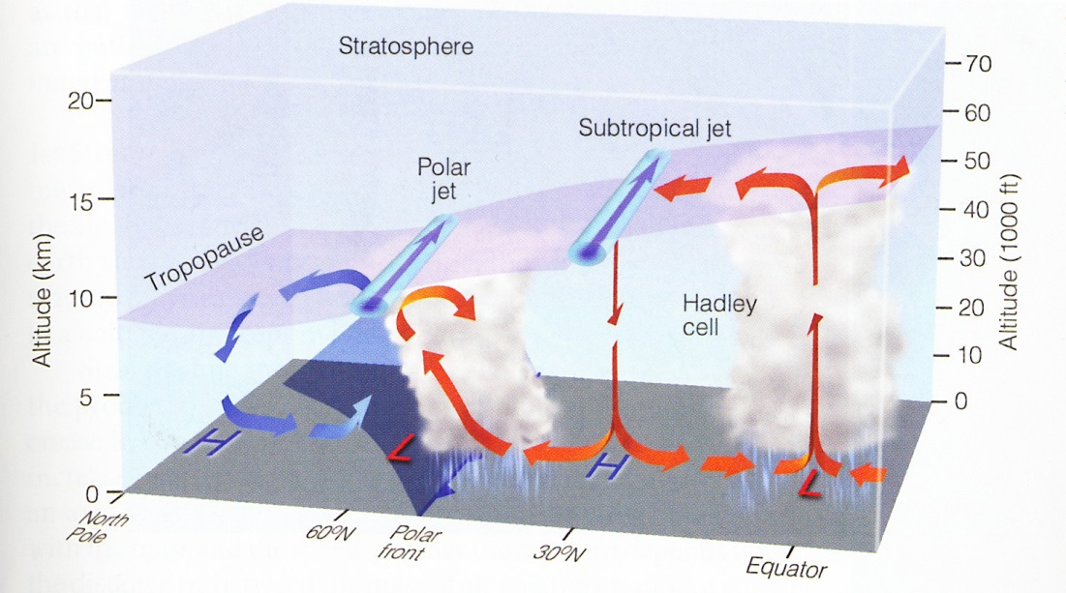

Slide 11
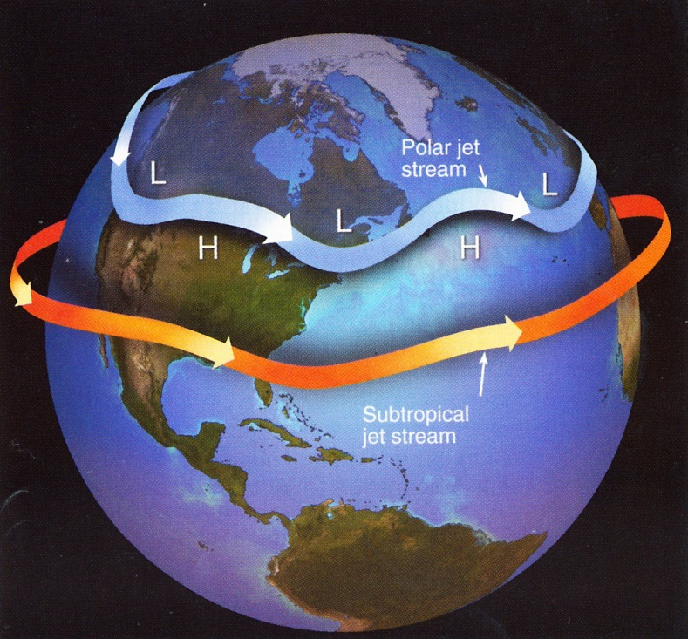
←Polar Jet Stream
←Sub-Tropical Jet
Stream
Average position
of the jet streams
in N. Hemisphere
winter

Slide 12
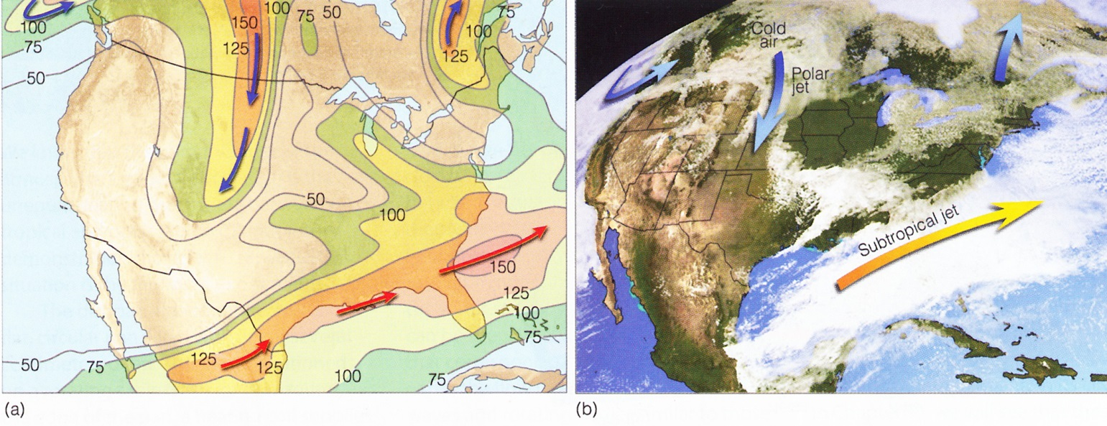
300mb map showing the Polar Jet with BLUE
arrows and the Sub-tropical Jet with RED arrows
The Polar Jet is sweeping south over the
Great Plains with strong Sub-tropical Jet
over the Gulf states brings moisture in the
form of a dense cloud cover over the S.E.
United States.

Slide 13
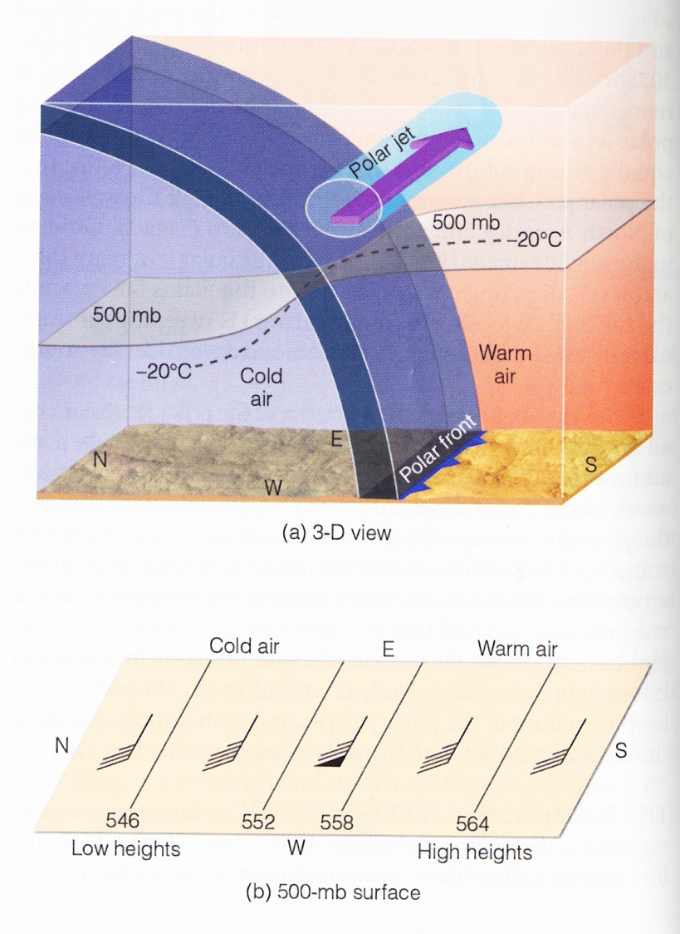
Note the sharp changes in pressure and
temperature across the Polar Front
Any horizontal change in temperature
causes isobaric surfaces to dip –
the greater the temperature difference
the greater the slant and the stronger the
winds.

