Slide 1
Moravec’s Paradox

Slide 2
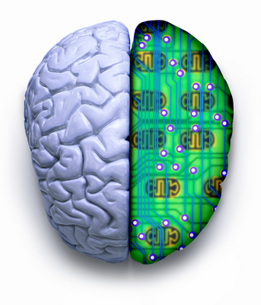
The Background Information

Slide 3
The Paradox
Hans Moravec’s paradox was that while computers are more than capable of executing solutions for difficult problems, they tend to solve common sense problems (easily solved by humans)

Slide 4
The Human Brain
The human brain as an organ consisting of billions of neurons (motory neurons, sensory neurons and interneurons) that connect.
  connecting neurons store memories, “distributing information and generating thoughts” through sensations received from the outside world; providing different responses to any given situation. (cognitive process)
  Our perception of the outer world is received through our sensory organs. The ability to see, taste, smell, feel and hear helps us form ideas of our surroundings. (all attribute to our mental states)

Slide 5
The Human Brain Ctd.
Memory:
  The memory process first involves codification, then retention, storage, and the recovery of this information.
  All the information perceived undergoes recoding constantly, allowing bits of information to be grouped according to their relational context, making decision making easier.

Slide 6
The CPU
Computers have “effective systems of memory recovery that call up the proper location and pull up exactly the same record that is stored”, a task rendered impossible for the human brain.
. It is clear that while the memory may be more reliable and accurate, the author insinuates that the computer is a slave to their architecture.
  “The type of intelligence that can be simulated depends on the software and not the hardware, with the consequent limitations that supposes for emulating human behaviour.”

Slide 7
The CPU Ctd.
Decision making in computers is characterised through algorithms, heuristics and recursive structures.
  Computer scientists insert algorithms for the computer to follow, a course of action used in order to solve a problem.
  Heuristics are created in order to base decision making around knowledge about a specific issue.
    The concepts of heuristic programming follows the structure of “IF…THEN” causing chains called productions.

Slide 8
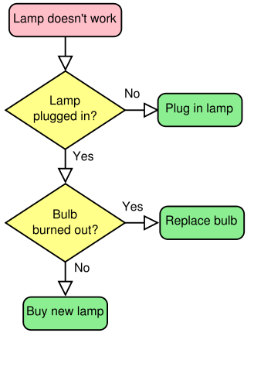
Decision Making for CPU

Slide 9
The Human Brain
The simplest form of action, reflex action, is based on a decision made. For example, when you touch a hot object, your initial reaction is to remove your hand.
Weigh the pros and cons of each solution and pick the best option. The goal of this process (problem solving) is to achieve a “reduced solution space”, where we have mentally passed and failed multiple solutions.

Slide 10
Vogel’s CSH vs RWH
In Vogel’s “Cartesian Skepticism and Inference to the Best Explanation” he postulates about the reasoning behind why we choose common-sense accounts of experiences versus radical alternatives, like Descartes evil genius reasoning.
  “Real World Hypothesis” (RWH), a belief that Vogel upholds as being explanatorily good because it sticks to the common sense view.
  the “Computer Skeptical Hypothesis” (CSH), a theory that Vogel likens to Descartes’ evil genius, he categorises this belief among the “elaborate fantasies of deception that may be tenuously connected to the content of one’s experiences and may lack cohesiveness”

Slide 11
Vogel’s CSH vs RWH Ctd.
Example of oblong bricks and an orange in both the RWH and the CSH to depict why the RWH is the better of the two.
. The fact the orange is a sphere and a sphere as the tendency to roll is self explanatory.
.In the CSH we assume “objects are just portions of a computer disk-the CSH will have to account for the relevant phenomena [the orange rolling] in some other fashion.” (pg. 663, Vogel)

Slide 12
Vogel’s CSH vs RWH Ctd.
In order for a hypothesis to fit the bill of being “explanatorily good” then:
If A implies B, A must be self-sustainable.
Simple explanations are considered better than the complicated.
If there needs to be some explanation, more is considered better.

Slide 13
The End

