Slide 1
A better Portal

Slide 2
Integrated degree progress and advice
Course Requirements
Necessary classes for major
Professor reviews/classroom reviews

Slide 3
Better scheduling / automatic scheduling
Real time information regarding:
Required texts
General class expenses
Automatic scheduling for different parts of the day
Alternate scheduling if classes unavailable
Broader information for new students
Maps to help find your classes

Slide 4
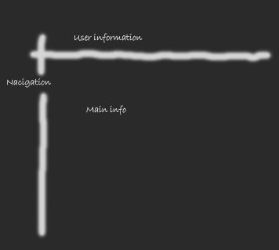
Easy to navigate web page

Slide 5
Easy to navigate web page continued…
Navigation bar on the left
Personal information at the top (Name, Gpa, Credits
Login brings user directly to registration process

Slide 6
Automatic Alerts
Better automatic alerts
Notifies you when
Classes are cancelled
Professors changed
Room changes

