Slide 1
Introduction to Computers
Prof. Sokol
Computer and Information Science
Brooklyn College

Slide 2
What is a Computer?
A COMPUTER is an electronic device that can:
Receive information
Perform processes
Produce output
Store info for future use.

Slide 3
Information Processing Cycle
Input
Process
Output
Storage

Slide 4
Hardware vs. Software
Hardware - the physical parts that make up the computer
e.g. CPU, memory, disks, CD-ROM drives, printer.
Software - computer programs and applications.
Operating system, word processor, games, etc.

Slide 5
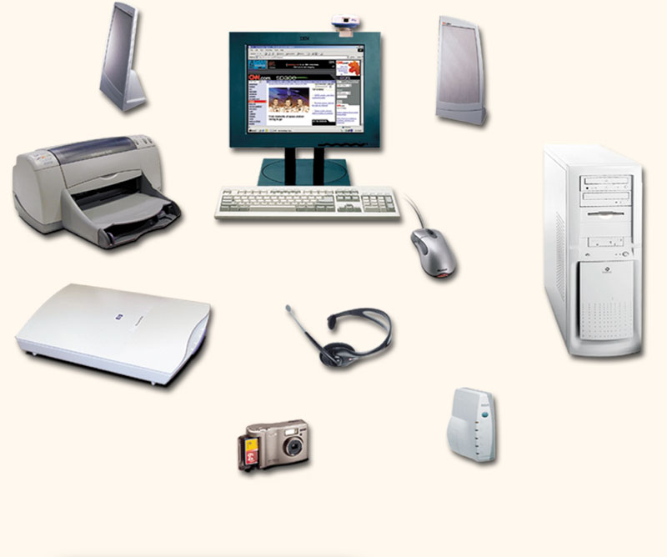
Hardware: physical devices that comprise a computer system
Monitor (output)
Speaker (output)
System unit
(processor, memory…)
Printer (output)
Storage devices
(CD-RW, Floppy, Hard disk, zip,…)
Mouse (input)
Scanner (input)
Keyboard (input)

Slide 6
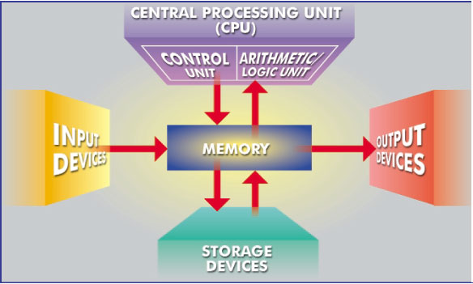
What Are The Primary Components Of A Computer ?
Input devices.
Central Processing Unit (control unit and arithmetic/logic unit).
Memory.
Output devices.
Storage devices.

Slide 7
Input Devices
Keyboard
Mouse
Scanner
Camera
Microphone
Touchpad
Stylus
…..

Slide 8
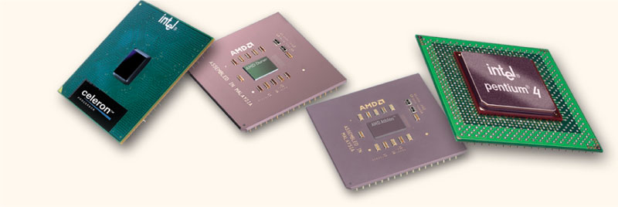
Central Processing Unit
The central processing unit (CPU) is the “brain” of the computer. It:
interprets instructions to the computer (control unit),
performs the arithmetic and logical processing (ALU)

Slide 9
CPU’s
CPU’s are measured by their (clock) speeds, or frequency of instructions per second. Example: 2.4 GHz
A multi-core processor has several processing units and can do more than one thing at a time. Example: duo or quad core.

Slide 10
Memory
Memory, also called Random Access Memory or RAM stores:
instructions waiting to be executed
data needed by those instructions
results of processed data
Any information stored in RAM is lost when the computer is turned off.

Slide 11
Memory
Data in memory is stored as binary digits (BITS) e.g. 011100101010
1 BYTE = 8 bits
1 byte usually stores 1 text character.

Slide 12
Memory (cont)
Memory can be viewed as a long list of numbered locations. Data can be written and erased from these locations.
There are usually several levels of memory. Cache is the fastest, most expensive kind of memory.

Slide 13
Amount Of RAM In Computers
We measure the size of memory by telling how many bytes it can hold.
1 kilobyte = 2¹⁰ bytes = 1024 bytes
1 megabyte = 2²⁰ bytes = ~1 million bytes
1 gigabyte = 2³⁰ bytes = ~1 billion bytes
1 terabyte = 2⁴⁰ bytes = ~1 trillion bytes
Typical RAM size: 4 to 16 GB.
Note: a 32 bit OS can only handle up to 4GB of RAM since 2³²=4GB.

Slide 14
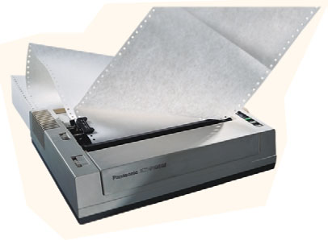
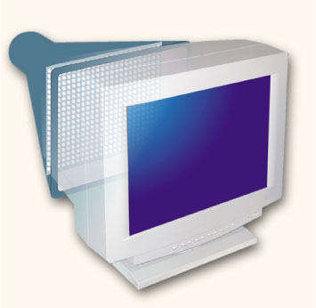
Output Devices
Output devices make the information resulting from the processing available for use.
printer - produces a hard copy of your output
screen - produces a soft copy of your output
speakers, etc.

Slide 15
Storage Devices
Auxiliary storage devices are used for permanent storage of data.
magnetic disks (hard disks, floppy disks)
optical disks (CD and DVD drives)
USB drives and flash memory cards

Slide 16
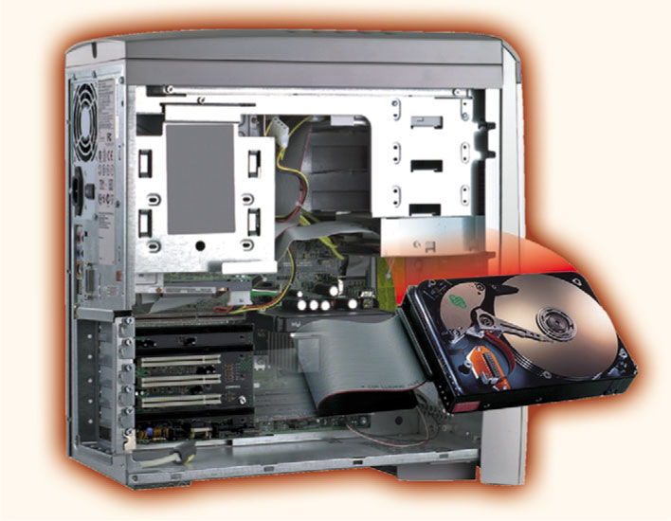
Hard Disks (magnetic storage)
Permanent storage that is inside of the computer, and NOT portable.
Consists of several platters which spin very fast
Typical hard disks range from 80 GB to 2 terabytes.

Slide 17
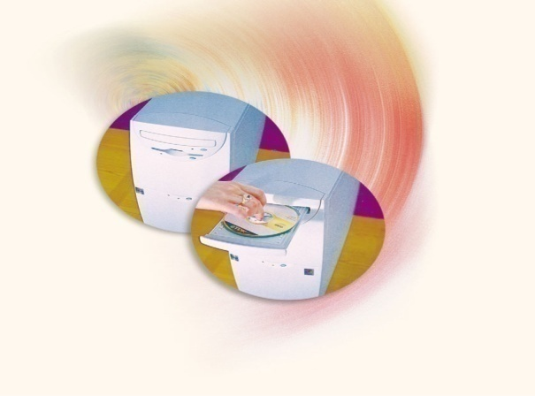
Optical Discs
Use laser to read and write:
CD-ROM (read only memory),
CD-RW – (rewritable)
DVD-ROM
DVD+RW
Typical CD’s can store about 700 MB
Typical DVD’s can store up to 17 GB

Slide 18
Software
A computer program or software tells it exactly what to do.
A computer program is a sequence of instructions to the computer.
The computer does one instruction at a time. (Note: each core performs one instruction at a time.)

Slide 19
Our goal….
This semester, our goal is to learn how to write our very own computer program.

