Slide 1
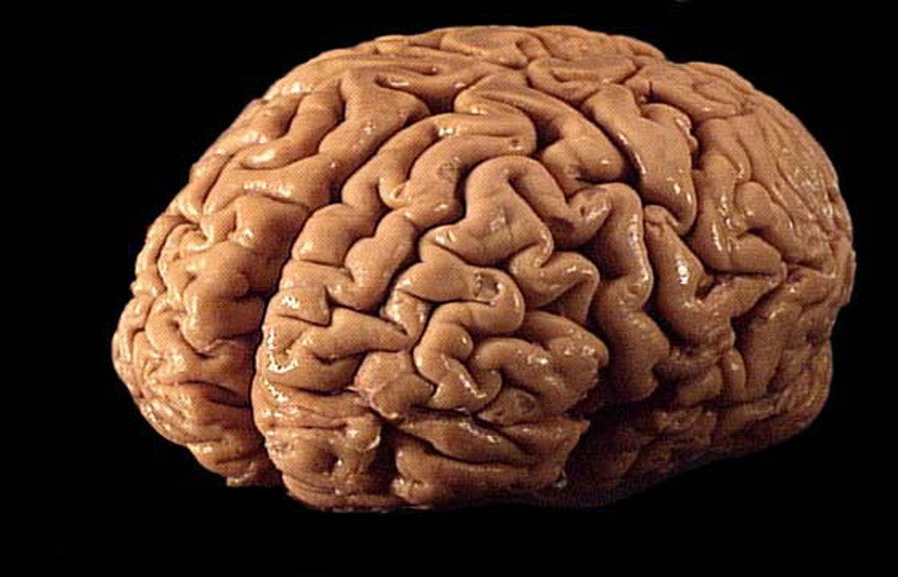
a computer scientist thinks about the Brain Christos H. Papadimitriou Columbia U

Slide 2
1936 – 1995:
the Computer

Slide 3
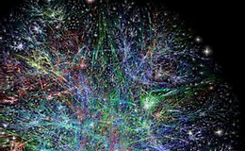
1995 – :
the Internet

Slide 4
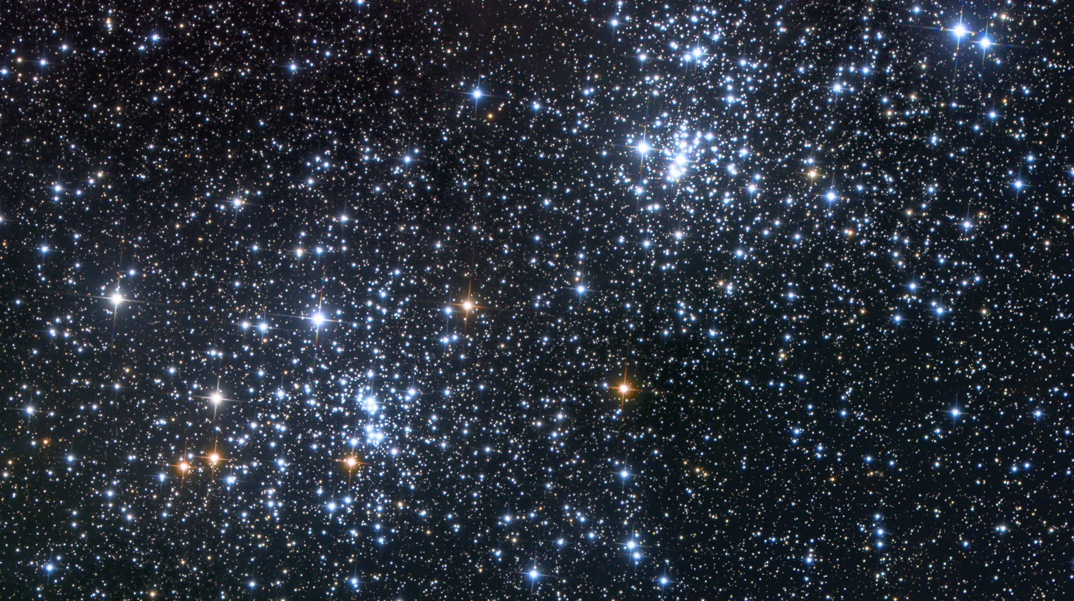
1995 – :
the Universe

Slide 5
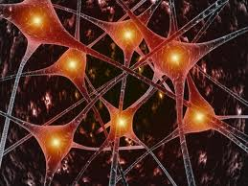
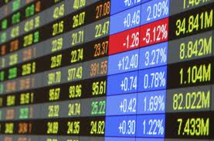
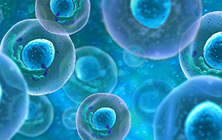
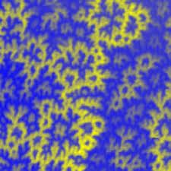
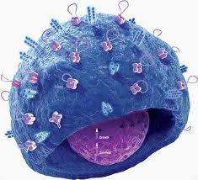
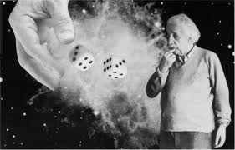
1995 – :
the universe

Slide 6
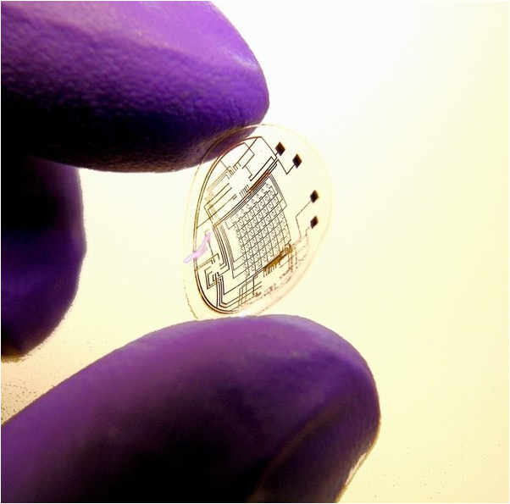
Computation as a lens on the Sciences

Slide 7
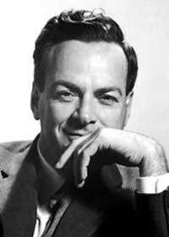
Quantum Computation: Turning a good question on its head
“Oh my God, how do you
simulate a quantum system
on a computer???”
“But what if we built
a computer out of these things?”

Slide 8
Statistical Physics: How does the lake freeze?
phase
transitions
change in
the speed of
convergence
of randomized
algorithms

Slide 9
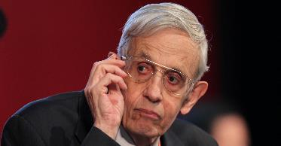
Game Theory and Economics
Finding
Nash
equilibria
is an
intractable
problem!

Slide 10
Evolution 150 years later
Q: “What algorithm could have done
all this! in a mere 10¹² steps?”
A: The equations for the evolution of a population of genotypes are tantamount to the genes playing a repeated game, with the alleles as strategies, through the multiplicative updates algorithm

Slide 11
Today:

Slide 12
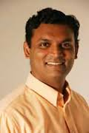
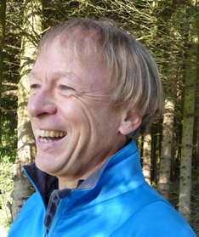
…work with…
Santosh Vempala
Georgia Tech
Wolfgang Maass
TU Graz

Slide 13
Brain and Computation:
The Great
Disconnects
Babies vs computers
Deep nets vs the Brain
Understanding Brain anatomy and function vs understanding the emergence of the Mind

Slide 14
How does the Mind emerge from the Brain?

Slide 15
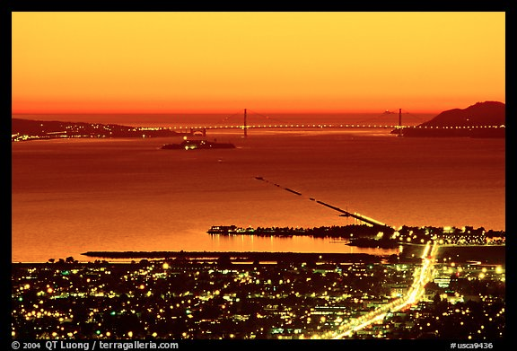
How does the Mind emerge from the Brain?

Slide 16
How does one think computationally about the Brain?

Slide 17
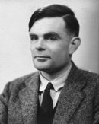
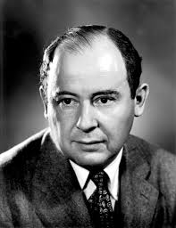
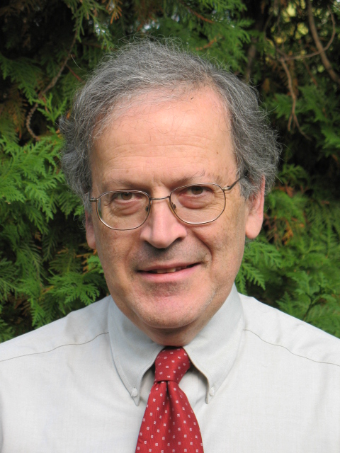
Good Question!
a computational theory
of the Brain is both possible and essential
[the way the brain works]
may be characterized by less
logical and arithmetical depth
than we are normally used to

Slide 18
David Marr (1945 – 1980)
The three-step program:
specs
algorithm
hardware

Slide 19
PCA?
SGD?
deep nets?
hashing?
decision trees?
Use Marr’s framework to identify
the algorithm run by the Brain!?
Linear programming?
SDP?
kernel trick?
EM?
SVM?
J-Lindenstrauss? FFT?
AdaBoost?

Slide 20
…Not!
Start by accepting defeat: Expect large-scale algorithmic heterogeneity (and algorithms that are either very simple or very complex)
Begin at a relatively safe place: Neuron assemblies encoding long term memories

Slide 21
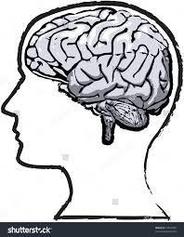
The experiment by [Ison et al. 2016]

Slide 22
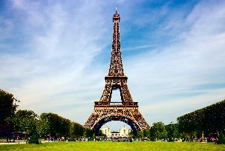
The experiment by [Ison et al. 2016]

Slide 23
The experiment by [Ison et al. 2016]

Slide 24
The experiment by [Ison et al. 2016]

Slide 25
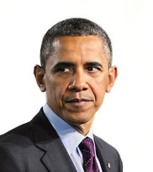
The experiment by [Ison et al. 2016]

Slide 26
The experiment by [Ison et al. 2016]

Slide 27
The experiment by [Ison et al. 2016]

Slide 28
The experiment by [Ison et al. 2016]

Slide 29
The experiment by [Ison et al. 2016]

Slide 30
The Challenge:
These are the specs (Marr)
What is the hardware?
What is the algorithm?

Slide 31
Speculating on the Hardware
A little analysis first
They recorded from ~10² out of ~10⁷ MTL neurons in every subject
Showed ~10² pictures of familiar persons/places, with repetitions
each of ~10 neurons responded consistently to one image
Hmmmm...

Slide 32
Speculating on Hardware (cont.)
Each memory is represented by an assembly of many (perhaps ~ 10⁴ - 10⁵ ) neurons;
cf [Hebb 1949], [Buzsaki 2003, 2010]
Highly connected, therefore stable
It is somehow formed by sensory stimuli
Every time we think of this memory
~ all these neurons fire
Two memories can be associated by “creeping” into each other

Slide 33
cells (or concept cells)

Slide 34
Algorithm?
How are assemblies formed?
How are they recalled?
How does association happen?

Slide 35
NP-completeness!
In a sparse random network, how can you select a densely connected subnetwork?
[Valiant 2017 to CHP]: assemblies
“infinitely harder”
(than items in his model)

Slide 36
“sensory
cortex”
MTL, ~10⁷ neurons
assembly
K ≈ 10⁴ neurons
stimulus
~10⁴ neurons

Slide 37
NB: these cells are scattered
~10⁴ neurons

Slide 38
sensory
cortex
stimulus
MTL, ~10⁷ neurons
assembly
~10⁴ neurons
~10⁴ neurons
synapses
random graph G_{n,p}
p ~ 10⁻²

Slide 39
But how does one verify such a theory?
Math?

Slide 40
Simplified model
G_{n,p} random directed graph of synapses
Later: “completion biases”
Fix integer K ~10⁴; at each discrete step, the K cells that receive the largest synaptic input will fire (implicit inhibition)
Plasticity: If i fires at time t and j at time t + 1, synapse ij is strengthened (by a small amount, up to a limit)

Slide 41
Linearized system
probability of activation
stimulus
x_{j}(t+1) = s_{j} + Σ_{i→j} x_{i}(t) w_{ij}(t)
w_{ij}(t+1) = w_{ij}(t) + β x_{i}(t) x_{j}(t + 1)
synaptic weights
plasticity

Slide 42
Linearized model: Result
Theorem: The linearized dynamics converges geometrically and with high probability to
x_{j} = s_{j} + Σ_{i→j} x_{i}²/Σ_{i→j} x_{i}
“To be successful, you either
have to be born rich,
or have many successful supporters,
or a little of both”

Slide 43
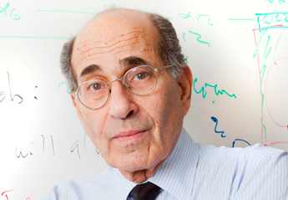
A distant mirror: olfaction in the mouse [al. et Axel 2011]
3
1
2

Slide 44
From the Discussion section of [al. et Axel]
An odorant may [cause] a small subset of … neurons [to fire].
This small fraction of ... cells would then generate sufficient recurrent excitation to recruit a larger population of neurons.
Inhibition triggered by this activity will prevent further firing
In the extreme, some cells could receive enough recurrent input to fire … without receiving [initial] input…

Slide 45
Linearized model: Result
Theorem: The linearized dynamics converges geometrically and with high probability to
x_{j} = s_{j} + Σ_{i→j} x_{i}²/Σ_{i→j} x_{i}
“To be successful, you either
have to be born rich,
or have many successful supporters,
or a little of both”

Slide 46
But how about the nonlinear system?

Slide 47
The nonlinear system theorem: a quantitative narrative
The high s_{j} cells fire first (“born rich”)
Next, some born rich cells and some cells with high { s_{j} + synapses from the born rich } fire (close to half and half)
“The rich get stably rich” through plasticity:
A few new cells may be recruited at each subsequent step, but such recruiting diminishes exponentially (all with high probability)
(Very few cells may end up oscillating in and out)

Slide 48
Mysteries remain...
And how are associations (Obama + Eiffel) formed?
And how can a set of random neurons have exceptionally strong connectivity?

Slide 50
High connectivity? Associations?
The G_{n,p} model needs some help…
[Song et al 2005]: reciprocity
and triangle completion
G_{n,p}++
p ~ 10⁻¹
G_{n,p}
p ~ 10⁻²

Slide 51
birthday
paradox!
also,
inside
assemblies

Slide 52
The association theorem
Upon the presentation of the stimuli sequence A, B, A + B, A, B,
(think: A = Eiffel, B = Obama)
a small but non-vanishing part of the cells in the assembly for A will also respond to B and vice-versa (with high probability, both in G_{n,p} and G_{n,p}++)

Slide 53
Also: Recall the challenge
In a sparse network, how can you select a densely connected subnetwork of K nodes?
Answer: Through a two-step algorithm
1. choose (1 – α) K nodes at random
2. choose the α K nodes most connected to those
(optimize α > 0)
+ triangle completion and birthday paradox
+ plasticity

Slide 54
Remember Marr?
The three-step program:
specs
algorithm
hardware

Slide 55
Another operation: Bind
e. g., “give” isa Verb
Not between assemblies, but...
...between an assembly and a Brain area
A pointer assembly, a surrogate for “give,” is formed in the verb area
Same process (and math...) as assembly creation

Slide 56
MTL
assembly pointer
“give”
verb area

Slide 57
Which brings us to: Language
An environment created by us a few thousand generations ago
A “last-minute adaptation”
Hypothesis: it evolved so as to exploit the Brain’s strengths
Invaluable lens for studying the Brain

Slide 58
Language!
Knowledge of language = grammar
Some grammar may predate experience: [Chomsky 1956 … 2016]
Grammatical minimalism (ca. 2010)
Merge: S → VP NP
Assemblies, Association and Assembly Pointers seem ideally suited for implementing grammar and language in the Brain.

Slide 59
Can we articulate a plausible Brain architecture for syntax?

Slide 60
Sooooooo… how does one think computationally about the Brain?
Assemblies of concept cells may be one starting point and path
Experimental Neuroscience and Cognitive Science provide specs, hardware
The algorithm vanishes into rudimentary iteration…
… and parameters, completion biases, architecture, evolution
Ultimately: language

Slide 61
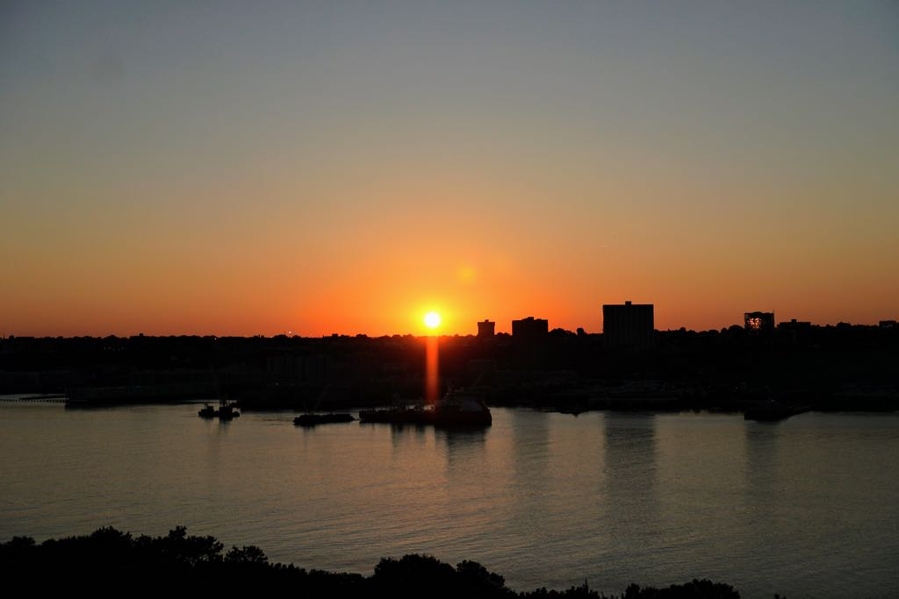
Thank You!

