Slide 1
Programming

Slide 2
Give Instructions
A robot will follow the instructions exactly as you give it.
Such as go forward and stop. The robot will not go forward, but rather stop, since there was no time interval given for how long to go forward.
You must give it a time interval. So that it becomes go forward for 2 seconds and stop.

Slide 3
Programming Structure
Plan
Pseudo Code – Fake Code
Think from a robot’s point of you. It cannot figure things out, it needs to be told exactly every little detail what to do.
  Go forward 10 inches
  Turn right 90 Degrees
Think about how it knows if it moved or turned a certain amount?

Slide 4
Turn Pseudo Code into Real Code
We will be programming the EV3 using LEGO MindStorms which uses a Block metaphor for programming the EV3.
The EV3 has supports for C/Java/Linux, but we won’t be using that in this class.

Slide 5
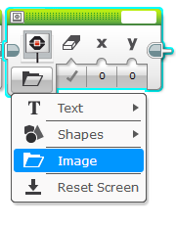
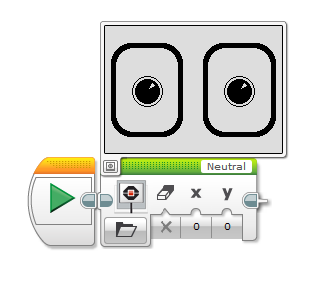
Display
Display Images. You can use the Tools, Image Editor to draw your own images.
Text
Drawing
Preview
Properties

Slide 6
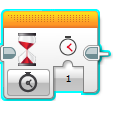
Wait Command

Slide 7
Animation
Use the Display & Wait Commands to make things move or change on the display.

Slide 8
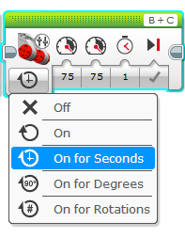
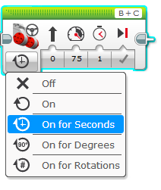
Motors
Direction
Steering
Power – Important for moving objects with the robot.
Duration
Braking vs Coasting
Move Tank
Move Steering

Slide 9

Commenting
Use the comment tool, to add comments to your code.
Comments help other you or programmers read your code. For your assignments, you MUST place some general comments to explain what the program does. As the term goes on and the projects become more complex, you will be asked to give more detailed comments at various sections of your programs.

Slide 10
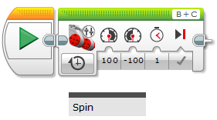
Sample Comment

Slide 11
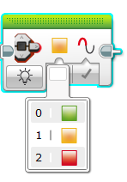
Status Light

Slide 12
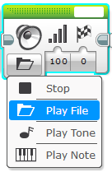
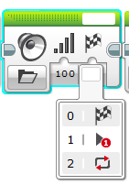
Play Sound/Note/Tone
Filename
Wait for completion?
Play Once
Loop Sound

