Slide 1
Storing Data

Slide 2
Local Storage
With local storage, web applications can store data locally within the user's browser.
Before HTML5, application data had to be stored in cookies, included in every server request. Local storage is more secure, and large amounts of data can be stored locally, without affecting website performance.
Unlike cookies, the storage limit is far larger (at least 5MB) and information is never transferred to the server.
Local storage is per origin (per domain and protocol). All pages, from one origin, can store and access the same data.

Slide 3
HTML Local Storage Objects
HTML local storage provides two objects for storing data on the client:
window.localStorage - stores data with no expiration date
window.sessionStorage - stores data for one session (data is lost when the browser tab is closed)

Slide 4
Testing
if (typeof(Storage) !== "undefined") {
// Code for
// localStorage/sessionStorage.
} else {
// Sorry! No Web Storage support..
}

Slide 5
The localStorage Object
The localStorage object stores the data with no expiration date. The data will not be deleted when the browser is closed.
// Store
localStorage.setItem("lastname", "Smith");
// Retrieve
var lastname=localStorage.getItem("lastname");

Slide 6
The previous example could have been written like this:
// Store
localStorage.lastname = "Smith";
// Retrieve
var lastname= localStorage.lastname;

Slide 7
Removing
localStorage.removeItem("lastname");

Slide 8
Note: Name/value pairs are always stored as strings. Remember to convert them to another format as needed.
Number(localStorage.quantity)

Slide 9
The sessionStorage Object
The sessionStorage object is equal to the localStorage object, except that it stores the data for only one session. The data is deleted when the user closes the specific browser tab.

Slide 10
JSON
JSON is a format for storing and transporting data.
JSON is often used when data is sent from a server to a web page.

Slide 11
What is JSON?
JSON stands for JavaScript Object Notation
JSON is lightweight data interchange format
JSON is language independent *
JSON is "self-describing" and easy to understand
* The JSON syntax is derived from JavaScript object notation syntax, but the JSON format is text only. Code for reading and generating JSON data can be written in any programming language.

Slide 12
JSON Example
{
"employees":[
{"firstName":"John", "lastName":"Doe"},
{"firstName":"Anna", "lastName":"Smith"},
{"firstName":"Peter", "lastName":"Jones"}
]
}

Slide 13
The JSON Format Evaluates to JavaScript Objects
The JSON Format Evaluates to JavaScript Objects.

Slide 14
JSON Syntax Rules
Data is in name/value pairs
Data is separated by commas
Curly braces hold objects
Square brackets hold arrays
{
"employees":[
{"firstName":"John", "lastName":"Doe"},
{"firstName":"Anna", "lastName":"Smith"},
{"firstName":"Peter", "lastName":"Jones"}
]
}

Slide 15
JSON Data - A Name and a Value
JSON data is written as name/value pairs, just like JavaScript object properties.
A name/value pair consists of a field name (in double quotes), followed by a colon, followed by a value:
"firstName":"John"

Slide 16
JSON Objects
JSON objects are written inside curly braces.
Just like in JavaScript, objects can contain multiple name/value pairs:
{"firstName":"John", "lastName":"Doe"}

Slide 17
JSON Arrays
JSON arrays are written inside square brackets.
Just like in JavaScript, an array can contain objects:
"employees":[
{"firstName":"John", "lastName":"Doe"},
{"firstName":"Anna", "lastName":"Smith"},
{"firstName":"Peter", "lastName":"Jones"}
]
In the example above, the object "employees" is an array. It contains three objects.
Each object is a record of a person (with a first name and a last name).

Slide 18
Converting a JSON Text to a JavaScript Object
A common use of JSON is to read data from a web server, and display the data in a web page.
For simplicity, this can be demonstrated using a string as input.
First, create a JavaScript string containing JSON syntax:
var text = '{ "employees" : [' +
'{ "firstName":"John" , "lastName":"Doe" },' +
'{ "firstName":"Anna" , "lastName":"Smith" },' +
'{ "firstName":"Peter" , "lastName":"Jones" } ]}';

Slide 19
Then, use the JavaScript built-in function JSON.parse() to convert the string into a JavaScript object:
var obj = JSON.parse(text);
document.write(obj.employees[1].firstName + " " + obj.employees[1].lastName);

Slide 20
Sending Data
If you have data stored in a JavaScript object, you can convert the object into JSON, and send it to a server:
var myObj = { "name":"Jonny", "age":30, "city":"New York" };
var myJSON = JSON.stringify(myObj);
window.location = "demo_json.php?x=" + myJSON;

Slide 21
Receiving Data
If you receive data in JSON format, you can convert it into a JavaScript object:
var myJSON = '{ "name":"John", "age":30, "city":"New York" }';
var myObj = JSON.parse(myJSON);
document.write(myObj.name);

Slide 22
Storing Data
//Storing data:
myObj = { "name":"John", "age":30, "city":"New York" };
myJSON = JSON.stringify(myObj);
localStorage.setItem("testJSON", myJSON);
//Retrieving data:
text = localStorage.getItem("testJSON");
obj = JSON.parse(text);
document.write(obj.name);

Slide 23
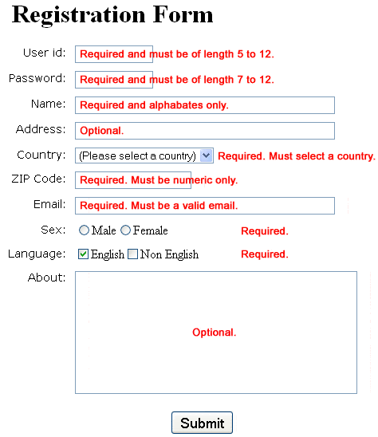
Form Verification - Link

