Slide 1
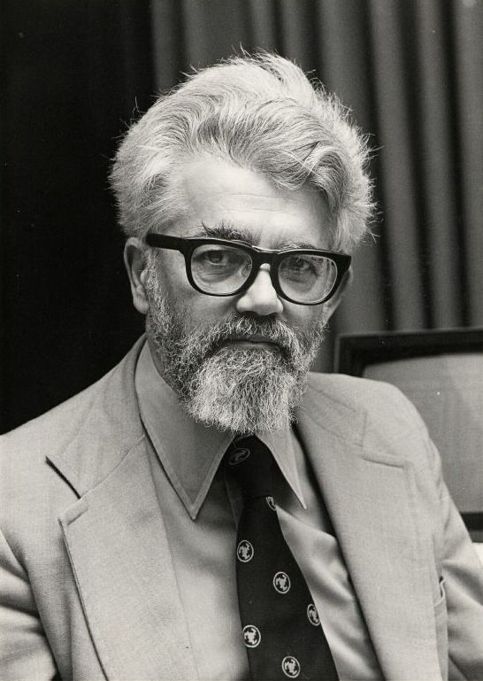
John McCarthy

Slide 2
biography
Was born in Boston, Massachusetts on September 4, 1927.
Family of two Irish immigrants, John Patrick and Ida Glatt McCarthy.
Received a B.S. in Mathematics in 1948 at Caltech.
Received a PhD in Mathematics from Princeton University in 1951.

Slide 3
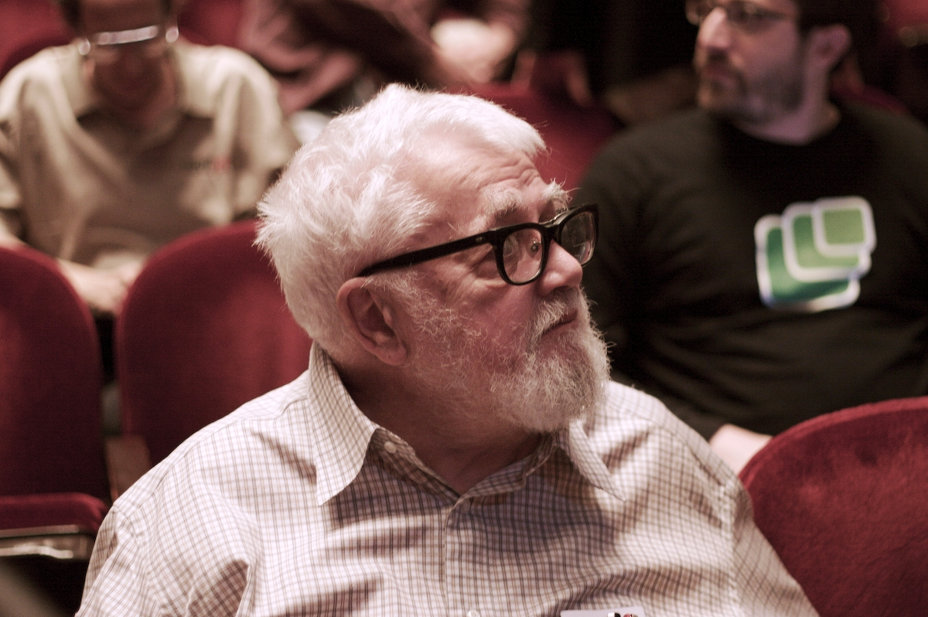
John McCarthy an American computer scientist, who received the Turing Award in 1971 for his major contribution to the field of Artificial Intelligence.

Slide 4
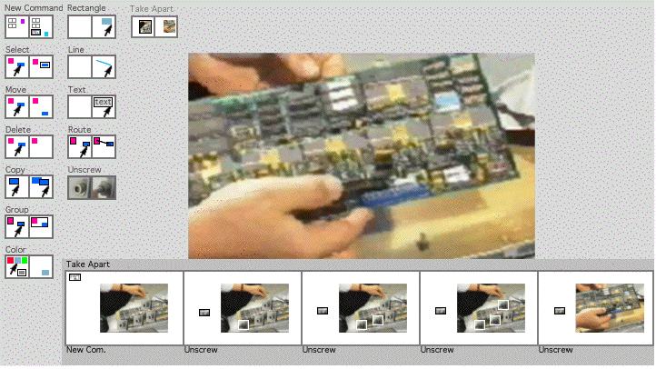
Advice Taker
In 1958, he proposed the advise taker, which inspired later work on question-answering and logic programming. It was a hypothetical computer program, "Programs with Common Sense”. It was probably the first proposal to use logic to represent information in a computer.

Slide 5
He helped to motivate the creation of Project MAC at MIT(1960)
He was the first to publicly suggest(in a speech given to celebrate MIT’s centennial) that computer time-sharing technology might lead to a future in which computing power and even specific applications could be sold through the utility business model(like water or electricity)(1961).
From 1978 to 1986, McCarthy developed the circumscription method of no monotonic reasoning.

Slide 6
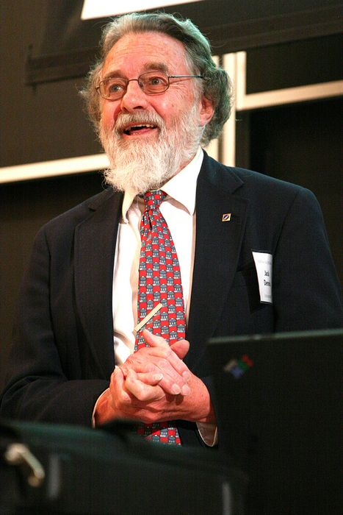
Jack Dennis
He was a MIT undergraduate, when joined the VI-A Cooperative program in Electrical Engineering, working at the Air Force Cambridge Research Laboratories on projects in speech processing and novel radar systems.

Slide 7
As a graduate student, he was an early user of the Whirlwind computer, and developed an innovative program for solving the “transportation problem”, a classical case of linear programming.
He completed the doctorate in Electrical Engineering in 1958.
He then joined the MIT faculty in the Department of Electrical Engineering and was promoted to full professor in 1969.

Slide 8
Professor Dennis designed an extensive set of hard ware alterations and additions to a DEC PDP-1 computer to create a time-shared computer system suited to support research in electronics, communications, and computer science.
That was one of the first interactive, time-shared computers that began operation around 1963.

Slide 9
1963 to 1985 Leader of the Computation Structures Group, MIT Laboratory for Computer science.
1984-won ACM/IEEE Award.
He also provided consulting services to computer manufactures including Digital Equipment Corporation, IBM, RCA, and Burroughs.

Slide 10
Professor Dennis developed 6 subjects in new areas of computer theory and computer systems
Theoretical Models for Computation.
Computation Structures.
Structure of Computer Systems.
Semantic Theory for Computer Systems.
Semantics of Parallel Computation.
Computer System Architecture.

